Slide 1
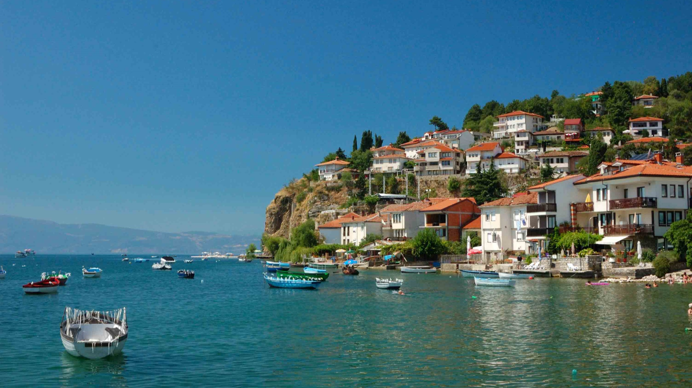

National tourism strategy
Republic of North Macedonia
Final Version by Kohl & Partner

Slide 2
National Tourism Strategy for North Macedonia
THIS DOCUMENT IS A RESULT OF THE PROJECT “PREPARATION OF THE NATIONAL STRATEGY FOR THE DEVELOPMENT OF TOURISM 2016 – 2021”, IMPLEMENTED BY THE MINISTRY OF ECONOMY
Executor:
Kohl & Partner DOO Skopje
ul. Makedonija br. 43
Skopje, North Macedonia
E-mail: skopje@kohl.at
www.kohl-int.com
Project Manager:
Mr. Christopher Hinteregger
Head of Publication:
Mr. Aleksandar Ivanovski
Disclaimer
This National Tourism Strategy for North Macedonia has been prepared by Kohl & Partner with a clear conscience based on our experience with similar projects and should support the responsible public administrations to take the right decisions regarding the development of tourism in the Republic of North Macedonia.
Any future decisions are in the sole responsibility of the acting institutions – Kohl & Partner cannot be made liable for any decisions, based on this report.
The current National Tourism Strategy displays all the information available at the time of conducting the study and was based on several site visits and interviews in the country as well as already existing reports.
This report should be seen as the continuation of the National Tourism Strategy 2009 – 2013 prepared by the North Macedonian government in 2009.
Christopher Hinteregger Project Manager
Coordination and Support:
Mr. Kreshnik Bekteshi,Minister of Economy
Mr. Kire Naumov, Deputy Minister of Economy
Mr. Zoran Pavlovski, State Secretary
Mr. Shovket Hazari, State Counsellor
Mr. Bekim Haxhiu, Head of Tourism Department
Publishing Date:
April 2018

Slide 3

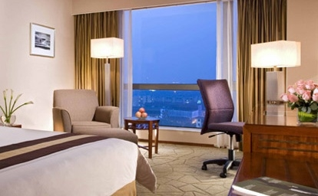
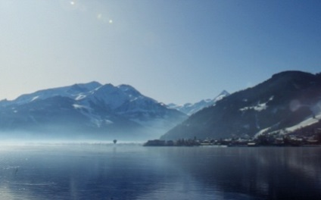

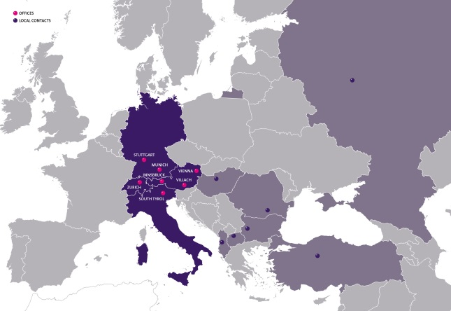
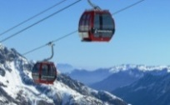
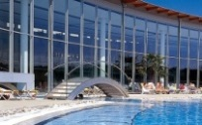

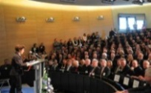
About Kohl & Partner
Kohl & Partner is an independent and internationally operating consulting company, specialized in the field of hotel and tourism development.
Kohl & Partner is the leading tourism consulting company in the Alpine Region, one of the most developed tourism regions in the world. Furthermore Kohl & Partner has implemented projects in more than 20 countries, has a broad network of local
Business Areas
Hotels & Resorts
partners and contacts and is therefore one of the biggest companies with this specialization in Europe. Clients of Kohl & Partner range from famous tourism destinations, leading companies, public authorities to well-known investors. Our tourism know-how, combined with more than 30 years of experience in the field of tourism development gives us the ability to act as a reliable partner for the development of international tourism projects.
Kohl & Partner means „quality in tourism“. The company is being developed and managed according to the EFQM-Modell for Business Excellence and won the “Austrian Quality Award” (a competition of the Austrian Ministry of Economics) for SMEs in Austria. Furthermore Kohl & Partner is an affiliate member of the UN World Tourism Organization and works in accordance with international consulting standards.
Beside the German speaking markets we put a special focus on Central, Eastern and South-eastern Europe. Currently we have offices and local contacts in eleven countries (Albania, Austria, Bulgaria, Germany, Hungary, Italy, North Macedonia, Romania, Russia, Switzerland and Turkey). In total more than 40 professionals are employed at Kohl & Partner
Tourism Destinations
Tourism Infrastructure

Slide 4
Table of contents (TOC)
National Tourism Strategy for North Macedonia
1. Evaluation of the National Strategy 2009 - 2013 4
2. Analysis of the current situation 16
3. Tourism development strategy 78
4. Action plan 2019 - 2021 109

Slide 5
Evaluation of the proposed actions from the National Tourism Strategy 2009 - 2013
National Tourism Strategy for North Macedonia

Slide 6
More than 80 actions had been proposed in the National Tourism Strategy 2009 – 2013
Evaluation of actions
Implemented actions
Pursue NASA claim on Kokino as a pre-historic observatory
Reconstruct Mother Theresa House
Develop a list and promote activity tourism products
Increase the number of quality pension style hotels
Regularize grey market accommodation
Prepare business plans for the National Parks
Introduce wine tourism as part of rural tourism
Develop scenic itinearies, walking paths, rural accommodation and restaurants in the wine region
Use crafts and culture in promotion activities
Create a directory of the main hiking trails
Provide favorable conditions for low cost carriers
Push for road improvements in the National Development Plan
Improve touristic signposting, extend use of brown tourism signposts and develop criteria for using such signs
Allow EU citizens to enter on National Identity Cards
Remove visa requirements for citizens of Albania
Prepare and implement management plans for all national parks and nature reserves
Create basic cultural heritage database
Prepare and implement cultural heritage protection plans
Create a tourism logo and slogan for North Macedonian tourism
Identify priority markets and segments for promotion
Compile and implement an annual marketing plan
Expand the tourism portal
Develop new and attractive promotion materials
Participate in international fairs, start promotion campaigns in media and cooperate with foreign tour operators
Ensure that tourism becomes the sixth economic sector given priority status by the government and Invest North Macedonia
Assist the process of land cadastre development
Recruit senior personnel for the tourism department within the Ministry of Economy
Engage short term technical assistance to support the tourism department within the Ministry of Economy
Engage long term technical assistance to support the Agency for Promotion and Support of Tourism
Align accommodation categorization criteria with European standards
Launch public awareness campaigns for tourism and visitor hospitality
Source: Personal interviews

Slide 7
Around 3/4 of all proposed actions have been implemented or partly implemented
Evaluation of actions
Partly implemented actions
Markovi Kuli – Prilep and Cocev Kamen – Kratovo should become World Heritage Sites
Develop itineraries to achieve regional spread
Increase the number of internationally recognized hotel brands in Skopje
Marketing, product development activities and creation of a directory for monastery accommodation
Review accommodation categorization criteria and introduce subjective elements
More activities offered in the National Parks and construction of two National Park centres
Improve mountain huts, children‘s and worker‘s accommodation facilities in the National Parks
Support for singposting and marketing for Tikves Wine Route
Joint effort to develop rural tourism in North Macedonia
Publish annual calender of events
Connect tour operators with the organizers of cultural events
Create packages for cultural events and festivals
Upgrade and renovate spa centres
Stricter controls regarding illegal hunting
Increase stock for hunting tourism by establishing a game reproduction centre
Develop National Handicraft Centres and retail outlets for traditional crafts
Improve the training equipment in tourism education
Increase the percentage of practical training hours in tourism education
Develop training programs for tourism employees
Introduce waste management operations and public awareness schemes
Install litter disposal and designated fire / barbecue areas in natural reserves
Provide reception facilities and/or information points and appropriate signage for national parks and natural heritage sites
Municipalities and NGOs identify additional natural heritage sites requiring protection
Create a database of all tourism products and services
Strengthen governmental and private sector awareness of tourism’s role in the economy through seminar programs
Plan and organize Tourism Investment Forums
Source: Personal interviews

Slide 8
Around 1/4 of all proposed actions have not been implemented
Evaluation of actions
Not implemented actions
Signpost scenic routes to attract tourists to off highway attractions
Increase the number of recognized low-budget brands on Corridor X
Introduce annual fees for categorized accommodation facilities to finance the categorization process
Convert medical treatment destinations to health/spa destinsations
Prepare a spa strategy for North Macedonia
Develop training programs for employees at cultural heritage attractions
Marketing study and promotion activities for hunting tourism
Produce a comprehensive directory of conference facilities
Feasibility Study for a national conference centre
Develop show caves as tourism attractions
Conduct a labour force survey for tourism
Establish a Human Resource Development Committee within the Agency for Promotion and Support of Tourism
Immigration officials classify foreign visitor arrivals by purpose and publish monthly reports
Obtain occupancy data of registered accommodation facilities monthly and publish them on a monthly basis
Develop operational guidelines for Tourist Information Centres (TICs)
Deliver regular training to TIC staff
Regulate use of TIC name and logo
Introduce turnover monitoring system through Tourism Satellite Account
Set up a small business advisory service for tourism sector investors in the government
Constitute an Advisory Council to the Agency of Promotion and Tourism
Introduce tourism awareness / career opportunities into the high school curriculum
Source: Personal interviews

Slide 9
Evaluation of the main targets from the National Tourism Strategy 2009 - 2013
National Tourism Strategy for North Macedonia

Slide 10
North Macedonia increased the number of arrivals but was not able to reach the targeted number of the previous strategy
Arrivals
Target 2015**
816.000 arrivals (331.000 domestic arrivals & 485.000 foreign arrivals)
Arrivals (000) | 2010 | 2011 | 2012 | 2013 | 2014 | 2015
Domestic | 325 | 320 | 312 | 302 | 310 | 331
Foreign | 262 | 328 | 351 | 400 | 426 | 485
Total | 586 | 648 | 664 | 702 | 736 | 816
Arrivals (во 000)
586
702
736
816
648
664
In the National Tourism Strategy 2009 – 2013 the targeted amount of arrivals for 2015 was defined with 816.000 – it was not possible to reach this indicated figure, mainly due to an unexpected change in domestic demand (decreasing numbers instead of slightly increasing ones) – on contrary, the number of international arrivals exceeded the forecasted figure.
Source: Statistical office of North Macedonia
* CAGR = Compound Annual Growth Rate ** Defined in Tourism Strategy 2009-2013

Slide 11
The number of overnights are stagnating since 2008 with a gap of 600.000 overnights to the targeted figure of 2015
Overnights
Target 2015**
2.779.000 overnights (1.986.000 domestic arrivals & 793.000 foreign arrivals)
Overnights (000) | 2011 | 2012 | 2013 | 2013 | 2014 | 2015
Domestic | 1.418 | 1.340 | 1.276 | 1.276 | 1.273 | 1.357
Foreign | 755 | 812 | 882 | 882 | 922 | 1.039
Total | 2.173 | 2.152 | 2.157 | 2.157 | 2.195 | 2.394
Ноќевања (во 000)
2.020
2.173
2.152
2.157
2.195
2.394
In the National Tourism Strategy 2009 – 2013 the targeted amount of overnights for 2015was defined with 2,78 million – it was not possible to reach this indicated figure, mainly due to an unexpected change in domestic demand (a significant decrease in annual overnights instead of moderate increases) – on contrary, the number of international overnights exceeded the forecasted figure by almost 100.000.
Source: Statistical office of North Macedonia
* CAGR = Compound Annual Growth Rate ** Defined in Tourism Strategy 2009-2013

Slide 12

Around 50 success criteria have been defined in the National Tourism Strategy 2009 - 2013
Evaluation of success criteria
 | Level of implementation | Comment
Number of iconic products |  | Potential iconic products have been identified, but not fully developed yet
Signposts and travel maps for scenic routes are developed |  | No scenic routes have been developed yet
5 new high-quality international hotels |  | Higher quality hotels have been opened but there is still a lack of internationally branded hotels in North Macedonia
50 % increase in registered accommodation facilities |  | Only a 3 % increase of beds in registered accommodation facilities between 2008 and 2014
Completed and approved business plans for National Parks – NP centres and mountain huts built/improved |  | Not implemented
Tikves Wine Route realized with signposts and different tourism products |  | A particular wine route (theme route) has not been developed, but several Points of Interest exist
3 additional villages marketing themselves as rural destinations |  | The national tourism website presents several rural tourism villages but they are not fully developed yet
Annual event calendar published in hardcopy and online |  | Events/festivals are described on the national tourism website – there is also a calender, but badly mainainted
4 refurbished spa resorts with three star grading |  | The majority of the health destinations are still focusing on medical treatments in a rather decent environment
Seminar and training program for employees at cultural heritage sites |  | Not implemented
50 % increase in game stock and 50 % increase by hunters |  | Not implemented
Source: Personal interviews

Slide 13
Evaluation of success criteria
 | Level of implementation | Comment
Directory of conference facilities published in hardcopy and online |  | There is a link to an external website on www.exploringNorth Macedonia.com/mice
Conducted Feasibility Study for a national conference centre |  | No Feasibility Study has been conducted yet
Directory of monastery accommodation published in hardcopy and online |  | Only a guidebook in North Macedonian language has been published – no information is available online
National Handicraft Centre operating |  | There is no National Handicraft Centre yet
Hiking trail directory published in hardcopy and online |  | A hiking trail directory exists
2 caves developed in a touristic way |  | Only stock-taking has been done yet – no cave is developed as a tourism attraction
Game reproduction centre established |  | A central game reproduction centre has not been established
2 themed routes developed and signposted / 500 brown signs |  | No theme routes have been developed yet – brown touristic signs have been introduced and are installed
Increasing number of arrivals by tourists from EU and Albania |  | Arrivals from EU countries significantly increased (2008 – 2014), while less Albanian travellers are coming
Labour force survey completed |  | No labour force survey had been conducted
Increased percentage of population employed in tourism |  | Employment in tourism grew between 2008 and 2014, but the share of the total employment remained stable
Regular improvements in training and curricula in the tourism industry |  | Not possible to assess due to missing eveluation criteria
Evident waste management improvement |  | Not possible to assess due to missing eveluation criteria
Source: Personal interviews

Slide 14
Evaluation of success criteria
 | Level of implementation | Comment
Prepared management plans for the National Parks and the Nature Reserves |  | Not implemented
Creation of a cultural heritage database |  | Not implemented
Creation of a cultural heritage protection plan |  | Not implemented
Reception centres in all National Parks |  | Not implemented
Number of new natural heritage sites |  | Not possible to assess due to missing eveluation criteria
Monthly data from boarder control regarding the number of arrivals by purpose is published |  | This has not been introduced
Monthly occupancy levels of accommodation facilities are published |  | The statistical office is publishing monthly reports, but without occupancy figures
National tourism logo and slogan has been created |  | North Macedonia timeless has been introduced
Comprehensive information about tourism in North Macedonia is available online |  | The national tourism website includes manifold information, but is not properly maintained
Annual marketing plan of the Agency for Promotion and Support of Tourism |  | Annual marketing plans are prepared by the Agency and approved by the government
10 % annual increase in website visits |  | No figures received by the Agency for Promotion and Support of Tourism
TICs open seven days a week and increase in visitors |  | Only a few TICs are operating in North Macedonia and often not in an appropriate way
New promotional material |  | New promotion material has been produced
Source: Personal interviews

Slide 15
Evaluation of success criteria
 | Level of implementation | Comment
50 % increase in fair participation |  | Constantly increased, reaching 20 fairs in 2016 (annual program of Agency for Promotion and Tourism Support)
Tourism Satellite Account established |  | A Tourism Satellite Account has not been introduced
Seminar program to improve the understand of economic benefits from tourism has been conducted |  | Not implemented
Tourism granted priority status by the government |  | In the national strategy tourism development is defined as a priority
Small/medium size business advisory service for the tourism sector has been established |  | Such an advisory service has not been established
2 Tourism Investment Forums have been realized |  | No Tourism Investment Forum has been organized until 2015
Improvements in the registration process (regarding land ownership) |  | The cadastre plans have continuously been improved
Tourism department within the ministry has been strengthened and is fully operational |  | Know-how improved, but very limited human and financial resources
Fully operational Agency for Promotion and Support of Tourism |  | Agency for Promotion and Support of Tourism has been realized but limited human and financial resources
Advisory Council for the Agency for Promotion and Support of Tourism has been set up |  | Advisory Council has been established
Revised scheme of accommodation categorization criteria in place |  | In 2013 the criteria have been adapted to European standards
Increasing number of students studying tourism |  | Currently six institutions (private and public) are offering tourism studies in comparison to two in 2008
Source: Personal interviews

Slide 16
Table of contents (TOC)
National Tourism Strategy for North Macedonia
1. Evaluation of the National Strategy 2009 - 2013 4
2. Analysis of the current situation 16
3. Tourism development strategy 78
4. Action plan 2016 - 2021 109

Slide 17
Analysis of the current situation
National Tourism Strategy for North Macedonia
Global tourism 17
Supply and demand analysis 22
Economic importance 35
Trend analysis 40
Main destinations and attractions 47
Framework conditions 58
SWOT-analysis 75

Slide 18
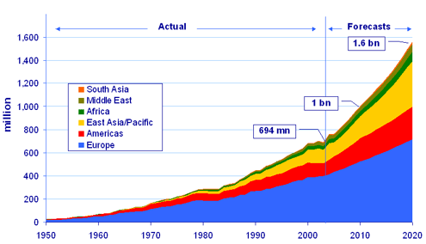
UNWTO's Tourism 2020 Vision forecasts that international arrivals will reach nearly 1,6 billion by the year 2020
Global tourism
At the beginning of the century the UN World Tourism Organization released a global forecast regarding the expected amount of international arrivals in 2020 – so for the first 20 years of the century. It was named Vision 2020 and included forecasts for every country.
International arrivals - UNWTO Tourism Vision 2020 (base year 1995)
South Asia
Middle East
Africa
East Asia/Pacific
Americas
Europe
in million | 1995 | 2010 | 2020 | CAGR*
Africa | 20 | 47 | 77 | 5,5 %
Americas | 110 | 190 | 282 | 3,8 %
East Asia/Pacific | 81 | 195 | 397 | 6,6 %
Europe | 336 | 527 | 717 | 3,1 %
Middle East | 14 | 36 | 69 | 6,7 %
South Asia | 4 | 11 | 19 | 6,2 %
World | 565 | 1.006 | 1.561 | 4,1 %
1.600
1,6 billion
1.400
1.200
1.000
1,0 billion
800
600
million
400
200
0
1950 1960 1970 1980 1990 2000 2010 2020
At the beginning of the century it was forecasted that the number of international arrivals will exceed 1 billion by 2010. The actual figure of 2010 was 950 million and in 2011 the officially published figure almost reach the 1 billion with 995 million international arrivals.
According to the latest published figures by the UN World Tourism Organization, based on actual results from the first months of 2015, tt is expected that the international arrivals will already reach around 1,2 billion in 2015. So that it is very likely, that the forecasted 1,6 billion in 2020 can be reached.
Source: UN World Tourism Organization
* CAGR = Compound Annual Growth Rate

Slide 19
Already in 2014 North Macedonia achieved more international arrivals as stated in the UNWTO forecast for 2020
Global tourism
International arrivals in Southeastern Europe - UNWTO Tourism Vision 2020 (base year 1995)
Comparison UNWTO forecast 2020 and actual figures 2014 (in million)
in 000 | 1995 | 2010** | 2020** | CAGR*
Albania | 40 | 51 | 133 | 4,6 %
Bosnia-H. | 37 | 248 | 444 | 10,5 %
Bulgaria | 3.466 | 6.226 | 10.635 | 4,6 %
Croatia | 1.324 | 7.454 | 10.017 | 8,4 %
Greece | 10.130 | 14.315 | 17.111 | 2,1 %
Romania | 2.757 | 5.732 | 8.484 | 4,6 %
Slovenia | 732 | 1.920 | 3.128 | 6,0 %
North Macedonia | 147 | 246 | 364 | 3,7 %
Turkey | 7.083 | 17.068 | 27.017 | 5,5 %
Serbia/Monten. | 228 | 643 | 1.669 | 8,3 %
The UNWTO also published the forecast for 2020 for each country. When taking a closer look at the countries in Southeastern Europe significant differences can be obtained. In some countries the forecasted figure for 2020 has already been reached by 2014 (Bosnia-Hercegovina, Croatia, North Macedonia and Serbia/Montenegro) – in some cases already significantly exceeded (Albania, Greece and Turkey). In Slovenia and Bulgaria the number of international arrivals can still reach the forecasted figure by UNWTO by 2020, while in Romania the forecast was too optimistic.
Source: UN World Tourism Organization
* CAGR = Compound Annual Growth Rate ** Forecast

Slide 20
North Macedonia is ranked 82nd out of 141 countries in the Travel & Tourism Competitiveness Index 2015
Global tourism
About the Travel & Tourism Competitiveness Index
The Index 2015
First compiled in 2007, the Travel & Tourism Competitiveness Index measures “the set of factors and policies that enable the sustainable development of the Travel & Tourism sector, which in turn, contributes to the development and competitiveness of a country”.
The methodology is organized into four subindexes and is based on 14 pillars.
1. Spain 5,31
2. France 5,24
3. Germany 5,22
4. USA 5,12
5. UK 5,12
6. Switzerland 4,99
7. Australia 4,98
8. Italy 4,98
9. Japan 4,94
10. Canada 4,92
11. Singapore 4,86
12. Austria 4,82
13. Hong Kong 4,68
14. Netherlands 4,67
15. Portugal 4,64
16. New Zealand 4,64
17. China 4,54
18. Iceland 4,54
19. Ireland 4,53
20. Norway 4,52
…
31. Greece 4,36
33. Croatia 4,30
39. Slovenia 4,17
44. Turkey 4,08
49. Bulgaria 4,05
66. Romania 3,78
67. Montenegro 3,75
82. North Macedonia 3,50
95. Serbia 3,34
106. Albania 3,22
…
134. Myanmar 2,72
135. Burundi 2,70
136. Burkina Faso 2,67
137. Mauritania 2,64
138. Yemen 2,62
139. Angola 2,60
140. Guinea 2,58
141. Chad 2,43
Travel & Tourism Competitive Index
Enabling Environment
T&T Policy and Enabling Conditions
Infrastructure
Natural and Cultural Resources
Business Environment
Prioritization of Travel & Tourism
Air Transport Infrastructure
Natural Resources
Safety and Security
International Openness
Ground and Port Infrastructure
Cultural Resources and Business Travel
Health and Hygiene
Price Competitive-ness
Tourist Service Infrastructure
Human Resources and Labour Market
Environmental Sustainability
ICT Readiness
Source: Travel & Tourism Competitiveness Index

Slide 21
North Macedonia achieved the best results in the field „Business environment“ – the worst in „Natural resources“
Global tourism
Travel & Tourism Competitiveness Index 2015
1 Business environment
2 Safety and security
3 Health and hygiene
4 HR and labour market
5 ICT readiness
6 Prioritization of T&T
7 International openness
8 Price competitiveness
9 Environmental sustainability
10 Air transport infrastructure
11 Ground and port infrastructure
12 Tourist service infrastructure
13 Natural resources
14 Cultural resources and business travel
 | 1 | 2 | 3 | 4 | 5 | 6 | 7 | 8 | 9 | 10 | 11 | 12 | 13 | 14
Greece | 4,0 | 5,5 | 6,6 | 4,7 | 4,7 | 5,4 | 4,1 | 3,9 | 4,2 | 4,2 | 4,0 | 6,1 | 3,5 | 2,8
Croatia | 3,7 | 6,0 | 6,3 | 4,4 | 5,0 | 4,5 | 4,1 | 4,3 | 4,4 | 3,1 | 4,2 | 6,3 | 3,8 | 2,7
Slovenia | 4,0 | 6,2 | 6,0 | 4,7 | 5,1 | 4,9 | 3,7 | 4,3 | 4,7 | 2,4 | 5,1 | 5,7 | 3,9 | 1,4
Montenegro | 4,4 | 5,7 | 5,7 | 4,9 | 4,4 | 4,6 | 2,4 | 4,5 | 4,3 | 3,0 | 3,5 | 5,8 | 2,8 | 1,1
North Macedonia | 4,9 34th | 5,8 45th | 6,0 42nd | 4,5 73rd | 4,5 55th | 4,4 81st | 2,4 104th | 4,6 79th | 3,6 107th | 2,4 85th | 3,3 81st | 4,6 59th | 2,1 121st | 1,3 110th
Serbia | 3,4 | 5,5 | 6,0 | 4,3 | 4,4 | 3,8 | 2,4 | 4,6 | 4,1 | 2,1 | 3,0 | 4,5 | 1,9 | 1,6
Albania | 4,1 | 5,3 | 5,2 | 4,7 | 4,1 | 4,0 | 2,3 | 4,4 | 3,6 | 2,2 | 3,0 | 3,9 | 2,0 | 1,1
Bulgaria | 4,2 | 5,2 | 6,7 | 4,7 | 4,8 | 4,2 | 3,9 | 5,1 | 4,6 | 2,5 | 3,3 | 6,1 | 3,4 | 2,0
Romania | 4,1 | 5,4 | 5,9 | 4,6 | 4,4 | 4,3 | 3,9 | 4,9 | 4,4 | 2,3 | 3,1 | 5,0 | 2,7 | 2,1
Turkey | 4,5 | 4,2 | 5,4 | 4,3 | 4,2 | 4,4 | 3,3 | 4,4 | 3,8 | 4,7 | 3,9 | 5,0 | 2,8 | 3,8
Source: Travel & Tourism Competitiveness Index

Slide 22
Analysis of the current situation
National Tourism Strategy for North Macedonia
Global tourism 17
Supply and demand analysis 22
Economic importance 35
Trend analysis 40
Main destinations and attractions 47
Framework conditions 58
SWOT-analysis 75

Slide 23
Currently around 71.000 beds in accommodation facilities are available in North Macedonia with a small increase since 2010
Beds in acccommodation facilities
Beds | 2010 | 2011 | 2012 | 2013 | 2014 | CAGR*
Hotels 5-star 4-star 3-star 2-star 1-star | 12.374 (18 %) 1.251 (2 %) 3.150 (5 %) 2.072 (3 %) 3.565 (5 %) 2.336 (3 %) | 13.317 1.488 3.715 3.474 2.393 2.247 | 13.884 1.680 3.833 3.730 2.684 1.957 | 14.724 1.740 4.170 3.806 3.092 1.916 | 15.543 (22 %) 2.152 (3 %) 4.483 (6 %) 4.323 (6 %) 2.753 (4 %) 1.832 (3 %) | 5,9 % 14,5 % 9,2 % 20,2 % -6,3 % -5,9 %
Private accommodation facilities | 26.132 (38 %) | 26.132 | 26.232 | 26.032 | 26.042 (37 %) | -0,1 %
Spa accommodation facilities | 1.217 (2 %) | 1.217 | 1.217 | 1.217 | 1.289 (2 %) | 1,4 %
Accommodation facilities for youth and children | 6.668 (10 %) | 6.668 | 6.674 | 6.596 | 6.590 (9 %) | -0,3 %
Camping | 8.971 (13 %) | 8.971 | 9.011 | 9.011 | 8.993 (13 %) | 0,1 %
Accommodation facilities for workers | 4.056 (6 %) | 3.996 | 3.993 | 3.851 | 3.911 (5 %) | -0,9 %
Other | 9.684 (14 %) | 9.436 | 9.276 | 8.866 | 8.857 (12 %) | -2,2 %
Total | 69.102 (100 %) | 69.737 | 70.287 | 70.297 | 71.225 (100 %) | 0,8 %
The number of available beds in registered accommodation facilities in North Macedonia increased from 69.000 in 2010 to 71.225 in 2014
The highest amount of available rooms are still in the category “private accommodation facilities” with a share of around 37 % of the total volume
The amount of beds in hotels increased from 12.300 in 2010 to 15.500 in 2014, with the biggest increase in the 3-star segment
Also the amount of available beds in the 5-star and 4-star segment increased, while the number of beds in the 2-star and 1-star segment decreased
In all other relevant accommodation types (private accommodation, spa accommodation facilities, accommodation facilities for youth and children, camping facilities and accommodation facilities for workers), the number of beds had been relatively stable between 2010 and 2014
Source: Statistical office of North Macedonia
* CAGR = Compound Annual Growth Rate

Slide 24
In 2015 North Macedonia generated around 816.000 arrivals with indicated a CAGR of 4,4 % since 2008
Arrivals
Arrivals (000) | 2008 | 2009 | 2010 | 2011 | 2012 | 2013 | 2014 | 2015 | CAGR*
Domestic | 350 | 329 | 325 | 320 | 312 | 302 | 310 | 331 | -0,8 %
Foreign | 255 | 259 | 262 | 328 | 351 | 400 | 425 | 485 | 9,6 %
Total | 605 | 588 | 586 | 648 | 664 | 702 | 736 | 816 | 4,4 %
Arrivals (in 000)
After a phase of decrease in 2009 and 2010 (in comparison to the previous year), the number of generated annual arrivals increased in any of the following years until 2015 reaching around 816.000 arrivals
Interesting is the development pattern if you compare the arrivals by domestic travelers with those of foreign ones - while the number of registered arrivals by North Macedonians decreased by around 20.000 between 2008 and 2015 (a negative CAGR of 0,8 %), the number of foreign arrivals increased by 230.000 (a positive CAGR of 9,6 %)
736
816
605
588
586
648
664
702
In 2011 the number of registered annual arrivals by foreigners was larger - for the first time - than the number of arrivals by domestic people
Source: Statistical office of North Macedonia
* CAGR = Compound Annual Growth Rate

Slide 25
In terms of international arrivals, North Macedonia is currently on the last position in the region
International arrivals
International arrivals in 2014 (in million)
Arrivals (000) | 2005 | 2010 | 2014 | CAGR*
Italy | 36,5 | 43,6 | 48,6 | 3,2 %
Turkey | 24,2 | 31,4 | 39,8 | 5,7 %
Austria | 20,0 | 22,0 | 25,3 | 2,6 %
Greece | 14,8 | 15,0 | 22,0 | 4,5 %
Hungary | 10,0 | 9,5 | 12,1 | 2,1 %
Croatia | 7,7 | 9,1 | 11,6 | 4,7 %
Czech Rep. | 9,4 | 8,6 | 10,6 | 1,3 %
Bulgaria | 4,8 | 6,1 | 7,3 | 4,8 %
Slovakia | 6,2 | 5,4 | 6,2 | 0 %
Albania | 0,6 | 2,2 | 3,3 | 20,9 %
Slovenia | 1,6 | 1,9 | 2,4 | 4,6 %
Romania | 1,4 | 1,3 | 1,9 | 3,5 %
Montenegro | n.a. | 1,1 | 1,4 | n.a.
Serbia | n.a. | 0,7 | 1,0 | n.a.
Bosnia-H. | 0,2 | 0,4 | 0,5 | 10,7 %
North Macedonia | 0,2 | 0,3 | 0,4 | 8,0 %
10,6
6,2
25,3
12,1
2,4
1,9
11,6
48,6
1,0
0,5
1,4
7,3
0,4
3,3
22,0
39,8
Although the number of international arrivals increased by around 8 % annually since 2005, North Macedonia is still on the bottom of the list compared with other countries in the region
Other land-locked countries in Central Europe have a significantly higher volume of annual international arrivals – e.g. Czech Republic with currently 10,6 million, Slovakia (6,2 million) or Hungary (12,1 million)
Neighboring Serbia has currently twice as many international arrivals
Source: UN World Tourism Organization
* CAGR = Compound Annual Growth Rate

Slide 26
After a period of stagnation (2008 – 2014), the number of overnights sharply increased in 2015 to almost 2,4 million
Overnights
Overnights (000) | 2008 | 2009 | 2010 | 2011 | 2012 | 2013 | 2014 | 2015 | CAGR*
Domestic | 1.648 | 1.518 | 1.461 | 1.418 | 1.340 | 1.276 | 1.273 | 1.358 | -2,7 %
Foreign | 588 | 584 | 559 | 755 | 812 | 882 | 923 | 1.036 | 8,4 %
Total | 2.236 | 2.102 | 2.020 | 2.173 | 2.152 | 2.157 | 2.196 | 2.394 | +1,0 %
Overnights (in 000)
The number of registered annual overnights in accommodation facilities in North Macedonia stagnated between 2008 and 2014 at a level of 2,0 to 2,2 million before increasing by 9 % between 2014 and 2015 reaching almost 2,4 million in 2015
While the number of domestic overnights decreased by almost 300.000 between 2008 and 2015 ( a negative CAGR of 2,7 %), an increase of almost 450.000 overnights was registered by foreign travelers (a positive CAGR of 8,4 %)
As a consequence the share of overnights by domestic travelers decreased from 74 % in 2008 to 57 % in 2015
2.236
2.173
2.152
2.157
2.196
2.394
2.102
2.020
Source: Statistical office of North Macedonia
* CAGR = Compound Annual Growth Rate

Slide 27
There is still a high concentration of overnights in July and August but with a smaller share than in 2008
Overnights – monthly distribution
Monthly distribution of overnights 2008 (000)
4 % 3 % 2 % 3 % 6 % 6 % 31 % 31 % 5 % 5 % 3 % 3 %
Monthly distribution of overnights 2015 (000)
3 % 3 % 3 % 4 % 7 % 7 % 22 % 30 % 8 % 6 % 4 % 3 %
The majority of the overnights in North Macedonia (1,24 million or 52 %) are still generated in the two summer months of July and August
The share of those two months dropped from 62 % in 2008 to 52 % in 2015 – mainly due to the fact, that the number of overnights in July decreased by more than 170.000 over this period of time
The months April to June and September to November all generated between 30.000 and 80.000 more overnights in 2015 in comparison to 2008
The demand in the other months (January to March and December) remained relatively stable on a rather low level
Source: Statistical office of North Macedonia

Slide 28
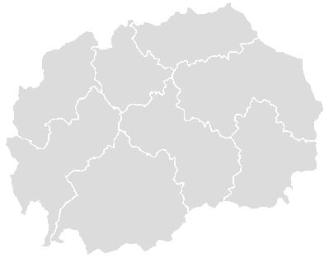
50 % of all overnights in North Macedonia are currently generated in the Southwest Region
Overnights – geographical distribution
1
Polog
As there are no administrative regions in North Macedonia eight statistical regions have been defined
50 % of the current annual overnights are generated in the Southwest Region, which includes the tourism-intensive municipalities of Struga and Ohrid at Lake Ohrid
With a share of around 19 % Skopje Region (with the capital) is in second position and Southeast Region (including the municipality of Dojran at Lake Dojran and the municipality Gevgelija at the Greek boarder) with 17 % in the third position regarding annual overnights
On the bottom of the table is the Northeast Region with only 15.000 annual overnights
3
2
Skopje
1
2
7
3
Northeast
4
Southwest
4
6
5
Pelagonia
8
6
Vardar
5
7
East
8
Southeast
Geographical distribution of overnights 2015 (000)
Share*
38 % 21 % 77 % 34 % 52 % 41 % 65 % 81 %
1.202
413
453
158
61
53
40
15
Source: Statistical office of North Macedonia
* Share of overnights by foreigners

Slide 29
In 2015 the two Lake Ohrid municipalities (Ohrid & Struga) accounted for 47 % of the annual overnights of North Macedonia
Overnights – distribution by municipalities
Overnights by municipalities 2015 (000)
Overnights (000) | Total 2015 | Domestic | Foreign | Foreign (%) | Ø length of stay | Total 2008 | CAGR* 2008 – 2015
Ohrid | 818 (34 %) | 499 | 320 | 39 % | 3,7 | 1.029 (46 %) | -3,2 %
Skopje (10 municipalities) | 328 (14 %) | 31 | 297 | 91 % | 1,7 | 212 (10 %) | 6,4 %
Struga | 301 (13 %) | 187 | 114 | 38 % | 4,7 | 287 (13 %) | 0,7 %
Dojran | 233 (9 %) | 223 | 11 | 5 % | 4,2 | 108 (5 %) | 11,6 %
Gevgelija | 123 (5 %) | 61 | 63 | 51 % | 2,4 | 67 (3 %) | 9,1 %
Debar | 71 (3 %) | 50 | 21 | 30 % | 6,9 | 58 (3 %) | 2,9 %
Krushevo | 59 (3 %) | 48 | 11 | 19 % | 2,6 | 63 (3 %) | -0,9 %
Strumica | 54 (2 %) | 41 | 13 | 24 % | 2,2 | 84 (4 %) | -6,1 %
Bitola | 51 (2 %) | 21 | 30 | 59 % | 2,0 | 62 (3 %) | -2,8 %
Other | 356 (15 %) | 197 | 156 | 44 % | 2,5 | 266 (12 %) | 4,3 %
Total | 2.394 (100 %) | 1.358 | 1.036 | 43 % | 2,9 | 2.236 (100%) | 1,0 %
The Top 5 municipalities regarding the number of annual overnights (Ohrid, Skopje, Struga, Dojran and Gevgelija) currently generate 75 % of all North Macedonian overnights
On top of the list is Ohrid with 818.000 overnights in 2015, followed by Skopje (328.000) and Struga (301.000)
The highest share of foreign overnights are currently registered in Skopje (91 %), the lowest in Dojran (5 %)
The majority of the bigger North Macedonian cities have a normal average length of stay of 1,7 to 2,6 days – the lake destinations of 3,7 to 4,7 days and Debar, as a spa destination, of almost 7 days
Dojran (11,6 %) and Gevgelija (9,1 %) achieved the highest CAGR in overnights since 2008, while the number of annual overnights decreased by 211.000 in Ohrid
Source: Statistical office of North Macedonia
* CAGR = Compound Annual Growth Rate

Slide 30
The popular lake destinations have a high seasonality with up to 95 % of overnights generated in July and August
Overnights – monthly distribution in Top 5 municipalities
Ohrid - monthly distribution of overnights 2015 (000)
Skopje - monthly distribution of overnights 2015 (000)
1 % 1 % 1 % 3 % 7 % 8 % 31 % 35 % 7 % 3 % 2 % 2 %
5 % 5 % 7 % 8 % 10 % 9 % 9 % 10 % 12 % 12 % 8 % 6 %
Struga - monthly distribution of overnights 2015 (000)
Dojran- monthly distribution of overnights 2015 (000)
1 % 0 % 0 % 1 % 6 % 7 % 36 % 38 % 6 % 3 % 1 % 1 %
0 % 0 % 0 % 1 % 1 % 1 % 25 % 70 % 1 % 0 % 0 % 0 %
Gevgelija - monthly distribution of overnights 2015 (000)
The amount of generated overnights are relatively equally distributed in Skopje (city and business tourism) and Gevgelija (gambling tourism)
A different picture can be obtained when having a closer look at the monthly distribution of overnights at the lake destinations – in Ohrid 66 % are generated in July/August and 22 % in May, June and September, while in Struga the ratio is 74 % and 19 % and in Dojran 95 % and 3 %
7 % 6 % 7 % 9 % 10 % 8 % 7 % 9 % 9 % 11 % 10 % 7 %
Source: Statistical office of North Macedonia

Slide 31
The demand for 3-, 4- and 5-star hotels nearly doubled from 21 % in 2010 to 41 % in 2014
Overnights – distribution by type of accommodation
Distribution of overnights by type of accommodation (000)
Overnights (000) | 2010 | 2011 | 2012 | 2013 | 2014 | CAGR*
Hotels 5-star 4-star 3-star 2-star 1-star | (34 %) 136 (7 %) 189 (9 %) 105 (5 %) 197 (10 %) 61 (3 %) | 888 177 328 193 115 75 | 937 170 371 224 121 51 | 1.005 188 385 255 129 49 | 1.045 (48 %) 196 (9 %) 413 (19 %) 283 (13 %) 116 (5 %) 37 (2 %) | 11,0 % 9,6 % 21,6 % 28,1 % -12,4 % -11,7 %
Private accommodation facilities | 754 (37 %) | 738 | 681 | 648 | 668 (30 %) | -3,0 %
Spa accommodation facilities | 216 (11 %) | 220 | 216 | 222 | 224 (10 %) | 0,9 %
Accommodation facilities for youth and children | 79 (4 %) | 65 | 62 | 68 | 64 (3 %) | -5,1 %
Camping | 110 (5 %) | 99 | 95 | 74 | 58 (3 %) | -14,8 %
Accommodation facilities for workers | 47 (2 %) | 63 | 49 | 51 | 51 (2 %) | 2,1 %
Other | 126 (6 %) | 100 | 112 | 89 | 86 (4 %) | -9,1 %
Total | 2.020 (100 %) | 2.173 | 2.152 | 2.157 | 2.196 (100 %) | 2,1 %
In 2014 the majority of the registered overnights in North Macedonia (78 %) had been generated in hotels and private accommodation facilities
It is assumed, that the real number of overnights in private accommodation facilities is significantly higher (grey market)
Foreign tourists mainly generate overnights in hotels (87 %), which implies, that the vast majority of the overnights in the other categories is generated by North Macedonians
Like in many other European countries, the number of overnights in upper hotel categories (3-, 4- or 5-star) is increasing, while the number of overnights in lower hotel categories (1- or 2-star) decreases - the most significant increases are registered in the 3- and 4-star segment with CAGRs of more than 20 %
The third most important type of accommodation – spa accommodation facilities – generated around 220.000 annual overnights in the last couple of years
Source: Statistical office of North Macedonia
* CAGR = Compound Annual Growth Rate

Slide 32
Domestic travelers are currently by far the most important source market (57 %) with an Ø length of stay of 4,1 days
Overnights – distribution by source market
Distribution of overnights by source markets (000)
Overnights (000) | 2010 | 2011 | 2012 | 2013 | 2014 | 2015 | CAGR*
Domestic | 1.461 (72,3 %) | 1.418 | 1.340 | 1.276 | 1.273 | 1.358 (56,7 %) | -1,5 %
Netherlands | 17 (0,8 %) | 112 | 145 | 127 | 128 | 169 (7,1 %) | 58,3 %
Turkey | 36 (1,8 %) | 65 | 81 | 105 | 97 | 135 (5,6 %) | 30,3 %
Serbia | 75 (3,7 %) | 73 | 71 | 74 | 77 | 85 (3,6 %) | 2,5 %
Greece | 43 (2,1 %) | 78 | 73 | 81 | 74 | 64 (2,7 %) | 8,3 %
Bulgaria | 29 (1,4 %) | 35 | 39 | 41 | 49 | 53 (2,2 %) | 12,8 %
Albania | 43 (2,1 %) | 36 | 35 | 41 | 42 | 39 (1,6 %) | -1,9 %
Germany | 23 (1,1 %) | 22 | 26 | 30 | 33 | 37 (1,5 %) | 10,0 %
Poland | 13 (0,6 %) | 14 | 18 | 30 | 38 | 36 (1,5 %) | 22,6 %
Croatia | 26 (1,3 %) | 29 | 29 | 26 | 32 | 31 (1,3 %) | 3,6 %
Other | 254 (12,6 %) | 291 | 295 | 326 | 353 | 387 (16,2 %) | 8,8 %
Total | 2.020 (100 %) | 2.173 | 2.152 | 2.157 | 2.196 | 2.394 (100 %) | 3,5 %
ALOS 2015**
4,1
5,3
1,5
1,9
1,7
1,8
2,1
2,1
2,1
2,0
-
2,9
Although the share of overnights generated by North Macedonians decreased from 72,3 % in 2010 to 56,7 % in 2015, the domestic travelers remain the most important source market
The second most important source market are currently the Netherlands with 169.000 overnights in (equaling a market share of 7,1 %), followed by Turkey, Serbia and Greece
The average length of stay in registered accommodation facilities in North Macedonia was 2,9 days in 2015
The majority of the Top 10 source markets achieved an average length of stay between 1,5 to 2,1 days in 2015 which implies a high percentage of business travelers from those countries
Only North Macedonians and Dutch travelers are staying significantly longer implying a high volume of leisure travelers
Source: Statistical office of North Macedonia
* CAGR = Compound Annual Growth Rate ** ALOS = Average length of stay

Slide 33
The current main source markets show different patterns regarding the monthly distribution of overnights
Overnights – monthly distribution of main source market
Netherlands - monthly distribution of overnights 2015 (000)
Turkey - monthly distribution of overnights 2015 (000)
0 % 0 % 1 % 1 % 12 % 17 % 22 % 25 % 19 % 4 % 0 % 1 %
2 % 2 % 4 % 10 % 18 % 9 % 13 % 16 % 13 % 7 % 4 % 3 %
Serbia - monthly distribution of overnights 2015 (000)
Greece - monthly distribution of overnights 2015 (000)
4 % 6 % 6 % 7 % 9 % 14 % 11 % 14 % 10 % 7 % 7 % 5 %
8 % 9 % 7 % 9 % 9 % 8 % 6 % 9 % 7 % 12 % 8 % 8 %
Visitors from the Netherlands are almost exclusively coming to North Macedonia between May and September (95 %) – therefore it can be assumed, that they are almost entirely leisure travelers spending a summer holiday in North Macedonia
On contrary the amount of generated overnights by the visitors from Greece are equally distributed year-round – therefore it can be assumed, that the majority of them are
generated in casino hotels near the boarder and in Skopje
Also the amount of overnights by visitors from Serbia are relatively equally distributed with a small peak during the summer months
Turkish visitors prefer the summer months between May and October (76 % of the generated overnights)
Source: Statistical office of North Macedonia

Slide 34
Between 2010 and 2014 North Macedonia achieved the highest CAGR of overnights by foreigners in the region
Overnights – foreign overnights by country
Overnights by foreigners (000)
Overnights (000) | 2010 | 2011 | 2012 | 2013 | 2014 | CAGR*
North Macedonia | 559 | 755 | 812 | 881 | 923 | 13,4 %
Regional competitors
Serbia | 1.452 | 1.643 | 1.796 | 1.988 | 2.161 | 10,5 %
Montenegro | 6.978 | 7.819 | 8.143 | 8.414 | 8.597 | 5,4 %
Bosnia-Hercegovina | 773 | 836 | 931 | 1.109 | n.a. | 12,8 %
Croatia | 50.992 | 54.751 | 57.522 | 59.680 | 61.324 | 4,7 %
Albania | 185 | 356 | 352 | 215 | 259 | 8,8 %
Romania | 2.685 | 2.982 | 3.001 | 3.168 | n.a. | 5,7 %
Bulgaria | 10.565 | 12.461 | 13.451 | 14.370 | 14.078 | 7,4 %
Greece | 48.986 | 54.518 | 51.095 | 57.748 | n.a. | 5,6 %
Other landlocked countries in CEE
Hungary | 9.614 | 10.411 | 11.392 | 11.983 | 12.351 | 6,5 %
Slovakia | 3.807 | 4.039 | 4.101 | 4.340 | 3.904 | 0,6 %
Czech Republic | 18.366 | 19.425 | 21.794 | 22.145 | 22.110 | 4,7 %
Population | Ratio**
2.100 | 0,4
7.200 | 0,3
600 | 14,3
3.800 | 0,3
4.300 | 14,3
2.800 | 0,1
20.000 | 0,2
7.300 | 1,9
11.000 | 5,3
9.900 | 1,3
5.400 | 0,7
10.500 | 2,1
Between 2010 and 2014 North Macedonia, with 13,4 %, achieved a larger CAGR of overnights by foreigners as the regional competitors and comparable landlocked countries in CEE
In 2014 only Albania generated less total annual overnights by foreigners than North Macedonia
The ratio of foreign overnights per inhabitant (0,4 in North Macedonia) shows a comparable ratio to countries like Serbia (0,3) and Bosnia-Hercegovina (0,3), but is far behind countries like Hungary (1,3) or the Czech Republic (2,1)
Source: UN World Tourism Organization
* CAGR = Compound Annual Growth Rate ** Foreign overnights per inhabitant

Slide 35
Analysis of the current situation
National Tourism Strategy for North Macedonia
Global tourism 17
Supply and demand analysis 22
Economic importance 35
Trend analysis 40
Main destinations and attractions 47
Framework conditions 58
SWOT-analysis 75

Slide 36
Tourism in North Macedonia currently contributes 5,2 % to the national GDP (2,3 % direct contribution and 2,9 % indirect)
Economic importance of tourism
Total tourism contribution to GDP 2014 (in %)
Contribution to GDP 2014 (per inhabitant, USD)
Croatia (28,6 %)
Malta (28,1 %)
Iceland (23,3 %)
1
2
3
1
2
3
4
…….
…….
5
Netherlands (5,6 %)
North Macedonia (5,2 %)
Lithuania (4,8 %)
38
39
40
40
41
42
43
44
The total contribution (direct and indirect) of tourism to the national GDP shows the importance of the tourism industry for a national economy. Currently the travel and tourism industry contributes 5,2 % to the national GDP of the Republic of North Macedonia – the country is therefore ranked on the 39th position out of 44 European countries.
This is the highest value since the year 2000, where the contribution had been 5,5 %. During the last 10 years the share varied between 4,2 % and 5,2 %.
The more meaningful figure, when it comes to evaluate the importance of tourism for the population of a country, is the total contribution per inhabitant.
In North Macedonia the total volume of the travel & tourism industry to the GDP was USD 288 per inhabitant. With this amount North Macedonia ranks 42nd out of 44 European countries, far behind the leading European countries (e.g. Iceland with USD 9.660) and on a comparable level with Serbia (USD 365) and the Ukraine (USD 205).
Source: WTTC

Slide 37
In 2014 the total contribution of tourism to the employment in North Macedonia was 33.100 people or 4,7 %
Economic importance of tourism
Total tourism contribution to employment 2014 (in %)
Tourism employment 2008 – 2014 in North Macedonia
Croatia (30,2 %)
Malta (29,1 %)
Iceland (23,7 %)
1
2
3
…….
Romania (5,5 %)
North Macedonia (4,7 %)
Lithuania (4,6 %)
40
41
42
According to the published data from the World Travel and Tourism Council, the number of people employed in tourism in the Republic of North Macedonia nearly tripled from 10.000 to 27.000 from 1998 to 2000.
After a decline at the beginning of the 21st century the figures reached around 27.000 in 2008 and 2009 again.
Since 2010 the number of people employed in tourism in the Republic of North Macedonia continuously increased, reaching 33.100 in 2014.
Regarding the amount of people employed in the tourism industry in comparison to the overall employment in the country, the Republic of North Macedonia is ranked on the 41st position out of 44 European countries.
In 2014 around 4,7 % of the employed North Macedonian workforce was (directly or indirectly) employed in the tourism industry. In Europe only Lithuania (4,6 %), Poland (4,3 %) and Moldova (2,3 %) had a lower percentage in 2014.
Source: WTTC

Slide 38
Accommodation facilities and restaurants have a share of 1,6 % of the national GDP and 3,7 % of the total employment
Economic importance of tourism
Contribution of accommodation facilities and restaurants to the national GDP 2008 – 2013 (MKD billion)
Employment in accommodation facilities and restaurants in North Macedonia 2009 – 2014 (000)
CAGR*:
3,0 %
CAGR*:
2,4 %
According to the published data from the statistical office of North Macedonia, the contribution from the area “accommodation and food service activities” to the national GDP increased from MKD 13,1 billion in 2008 to MKD 15,2 billion in 2013.
The increase from 2012 to 2013 followed four years of stagnation, where the contribution remained relatively stable between MKD 10,6 and 11,6 billion.
The figures between 2008 and 2013 represents a Compound Annual Growth Rate of 3,0 % and at the same time a share of 1,2 – 1,6 % of the national GDP of the Republic of North Macedonia.
According to the published data from the statistical office of North Macedonia, the number of people employed in the category “accommodation and food service activities” increased from 21.850 in 2009 to 24.720 in 2014.
This represents a Compound Annual Growth Rate of 2,4 % between 2009 and 2014 and at the same time a stable share of 3,5 – 3,7 % of the total employed population of the Republic of North Macedonia.
The figure of employed people in accommodation facilities and restaurants continuously grew between 2009 and 2014, with the exception of 2012.
Source: Statistical office of North Macedonia
* CAGR = Compound Annual Growth Rate

Slide 39
The North Macedonian government spends only 1,3 % of the total government budget on tourism
Economic importance of tourism
Government expenditure on tourism as a percentage of total government budget
1
2
3
4
5
6
7
8
9
10
18
47
57
69
91
114
124
125
136
137
According to the published data in the Travel & Tourism Competitiveness Index the Seychelles and the Dominican Republic are on top of the list of those countries with the highest share of government expenditure on tourism in relation to the total government budget. They both have values of more than 20 %, followed by another seven countries with contributions between 10 and 20 %. The first six countries are all islands and in the top 10 are only two European countries (Malta and Iceland).
North Macedonia is ranked on position 125 out of 141 countries with a percentage of 1,3 % in 2014. In the region only Serbia and Turkey had a lower percentage in 2014. Although the presented figures provide a first insight in governmental spending on tourism, still they need to be seen as approximate values as it is not clear if the same elements are included in each country.
Source: Travel & Tourism Competitiveness Index

Slide 40
Analysis of the current situation
National Tourism Strategy for North Macedonia
Global tourism 17
Supply and demand analysis 22
Economic importance 35
Trend analysis 40
Main destinations and attractions 47
Framework conditions 58
SWOT-analysis 75

Slide 41


Global trends in tourism
Trend # 1: Health
All aspects connected with health (fitness, spa, physical activities, etc.) will further gain importance in the near future. Though increasing health-consciousness will not influence the volume of demand, it will certainly influence the decision-making with regard to destinations, and behaviour/activities during holidays. Competition is also growing in this segment, as private capital is injected into the upgrading of old style health and spa facilities.
Consequences for the tourism sector:
Destinations that are perceived less healthy will be more quickly avoided than in the past
The demand for sun-holidays will further decrease
Active or activity-based holidays will increase in popularity, and the demand for facilities that correspond to this type of holiday will be increasingly preferred
The demand for ‘wellness’ products will increase, including spas and fitness centres
Trend # 2: Less leisure time
Modern society exerts increasing pressure on peoples’ daily lives, and stimulates the wish for more leisure time and relaxation - which will have an adverse effect on the increase of free disposable incomes. For tourism, this trend is thus by definition unfavorable.
Consequences for the tourism sector:
An increasing need to supply additional low-cost products in order to address the middle class
An increasing need to offer relaxation in order to escape from the increasing demand of every-days life
A shortening of the longer main holiday in favor of more short ones – cities will especially benefit from this trend
Source: European Travel Commission

Slide 42
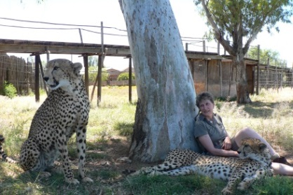
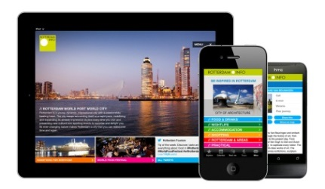
Global trends in tourism
Trend # 3: Increasing travel experience
More sophisticated consumers are increasingly self-assured regarding their needs and rights. For tourism, this results in an increasingly critical attitude to quality, and to the price-quality ratio.
Consequences for the tourism sector:
Experienced travelers are well versed in the organization aspects of their trips and the reservation / booking systems that service them. And they will demand higher quality experience and service at all levels of expenditure
Alternative ways of spending time and money will increasingly compete with holidaymaking
With fewer repeat visitors it might become difficult for destinations to build loyalty
More experienced tourists will increasingly result in a more critical attitude to the artificial, in favor of greater authenticity - in particular with reference to emotional satisfaction and the need to personalize
Trend # 4: Information technology
The use of the internet to purchase and to compare tourism products and services will constantly increase. As a result the consumer will assume more and more control. New electronic payment systems will be developed, secure credit cards, e-purse etc. These developments will make it easier to transfer money and to overcome concerns about excessive transfer charges, exchange rates and the security of moving money online.
Consequences for the tourism sector:
The ready availability of tourist information on destinations and products will lend itself to comparison, and thus influence competition more intensively
Experienced tourists will increasingly put together their own holidays on a modular basis with direct bookings
The internet will transform the classical role of the tourism organizations (e-marketing, CRM Destination Marketing)
Destination marketing (e.g. better branding with public support) will increase in importance as the source to stimulate website visits
Source: European Travel Commission

Slide 43

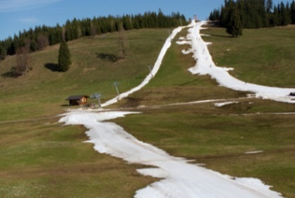
Global trends in tourism
Trend # 5: Demographics
People will live longer in the future and older age groups will therefore grow. These seniors are healthy and have a lot of spare time. But also the youth market (16 – 35 years old), which accounts for over 20% of global tourism is an important future target group. In upcoming markets such as China, India and Russia, younger segments will grow in the longer term.
Consequences for the tourism sector:
Leisure time increases for elderly people and therefore products for this age group have to be developed
Especially health tourism products are popular among seniors but also cultural tourism will register a increasing demand
On the other hand, the youth market will seek more active holiday products – particularly various forms of adventure tourism
These trends will likely lead to an increasing demand for independent holidays with a relative fall in demand for traditional package holidays. Individualized luxury destinations are also likely to develop further
Trend # 6: Climate change
Climate change affects and even threatens certain tourism destinations that are depending on their natural environment. The retreat of glaciers in Europe is only one proof of global warming. Still there are some doubts about the real effects of climate change.
Consequences for the tourism sector:
People will travel more outside the summer season - summer destinations become popular during traditional winter periods
The cost of maintaining basic “natural” resources for tourism such as beaches, lakes, rivers and winter sports areas will increase - in major mountain resorts for example, there will be an increased need for artificial snow
Higher demand for Eco-Tourism and Nature-Based holidays and the provision of more information on product sustainability by suppliers will help to increase tourists’ environmental awareness
The sustainability of tourism will be more important and therefore marketing activities in this direction are suggested
Source: European Travel Commission

Slide 44
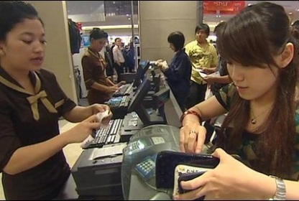
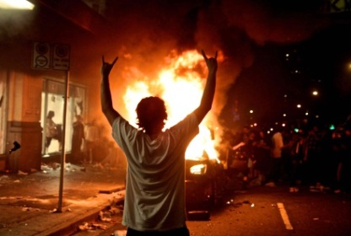
Global trends in tourism
Trend # 7: Macroeconomic Trends
The global economy will further grow. The BRIC economies Brazil, Russia, India and China are likely to be the fastest growing nations. Global trade in consumer good and services will further increase. Services (including tourism) will matter more in the world economy.
Consequences for the tourism sector:
The global environment is getting more competitive and tourist are searching for more economical travel experiences
New tourism destination in upcoming economies will appear, often seeking to use tourism promotion to strengthen their identities for political and economic purpose - at the same time these new economies will also represent new source markets
New products for emerging source markets need to be created
The travel expectations of young people will rise with the growth in globalization - central to satisfying these expectations will be the need to ensure that information and accommodation provided are of the right quality and accessible through all the latest information / communication channels
Trend # 8: Political factors
Costs for social demands, health, education, pensions and other services will further increase which force governments to raise taxes. Concerns about security, health and immigration issues will conduct to more control on travel by government.
Consequences for the tourism sector:
Latest travel advisory notices and security and safety information need to be coordinated by governments
The image of destination countries is increasingly likely to be linked to security and health issues - the number of tourists in long-haul markets who are required to apply for visas will grow
Security and health issues are more and more linked to the image of destination countries
To identify trustfully international operators, branding will be an important issue in the future
The consolidation of internet offers will continue
Source: European Travel Commission

Slide 45
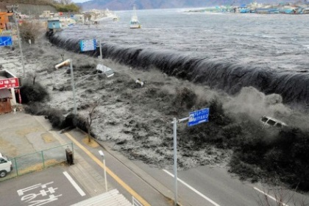
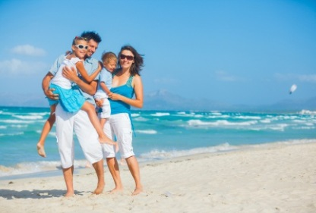
Global trends in tourism
Trend # 9: Safety & Security
Terrorist attacks targeting tourists or tourist destinations lead to a growing feeling of insecurity. The fear is even enlarged by media coverage. Also natural disasters, which seem to appear more frequently in the past, are bad for tourism. However, it is proved, that consumer attention spans are relatively short, also because people know that they can not do anything against it. Average people forget about major terrorist or natural incidents after only thee months.
Consequences for the tourism sector:
A disaster management, including a well planned information management and a recovery plan are required
Due to the unpredictability of the incidents which could lead to a redaction of tourism flows, a flexible planning is an important issue in today's world
Trend # 10: Lifestyle
Less differences in destinations can be found in the future. Unique places will more and more disappear. In the early days, travel was a luxury good but has become a normal part of life nowadays. The number of last-minute holidays and short trips is increasing. The freedom to travel will be extended by the trend towards older parenting and the growth in single parent households. New common-interest groupings and communities are increasingly becoming the main resource for orientation knowledge, entertainment and safety. Well-being, health & fitness, stress management products but also medical services in foreign countries register a higher demand.
Consequences for the tourism sector:
Development of niche products is recommended
Since travel has become “normal” a sinking demand in some markets is possible
Tourists want intense experiences during their holidays
Spiritual products based on inner experience as well as health and spa products area also likely to emerge
Source: European Travel Commission

Slide 46

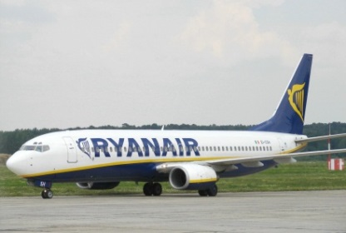
Global trends in tourism
Trend # 11: Trends in Marketing
Consumers are seeking advice from other consumers through the internet. Skilled consumers are increasingly likely to know more about niche products than many travel professionals. There will also be growing investment in internet strategies for promotion and in new research techniques. Additionally public / private partnerships are becoming more important in tourism marketing as governments seek to increase both stakeholder involvement and marketing budgets.
Consequences for the tourism sector:
Because of the internet it will become increasingly important to know more about consumers’ motivations and interests
Also the next generation of distributing of travel and tourism products will take place on the internet – therefore segmentation and positioning is getting more and more important
Marketing messages have to be more focused on experiences and feelings and personalized products will be in demand
Smaller travel budgets require new “budget” travel products
Trend # 12: Transport
Cars are the means of travel in 70% of all tourism journeys and will stay the most important vehicle. Low accessibility to city centres and cheap air travel have negative influence on coach travel. Also the growth of air travel could grow slower due to costs of fuel, security and airport charges. Governments invest more money in rail travel, especially in high-speed lines.
Consequences for the tourism sector:
New airports and other improved accessibility measures are very important for destinations – destinations that are not easily accessible will suffer
New destinations are being created through improved accessibility - the development of budget airlines is also changing travel pattern rapidly
To develop new visitor markets new air routes need to be implemented
Rail competes air travel – especially for shorter trips
Source: European Travel Commission

Slide 47
Analysis of the current situation
National Tourism Strategy for North Macedonia
Global tourism 17
Supply and demand analysis 22
Economic importance 35
Trend analysis 40
Main destinations and attractions 47
Framework conditions 58
SWOT-analysis 75

Slide 48
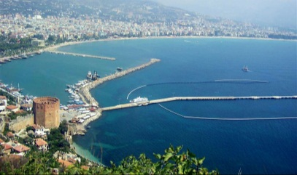
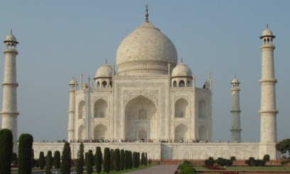
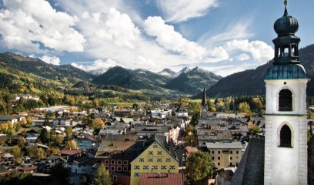
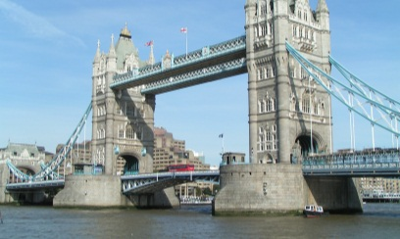
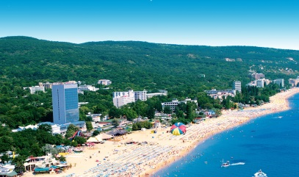
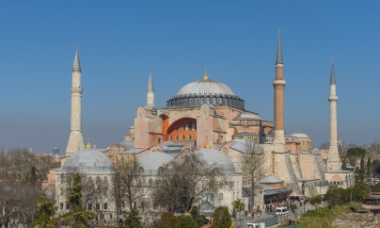
Modern tourism development distinguish between tourism destinations and tourism attractions
Main destinations and attractions
Tourism destination
Tourism attraction
A tourism destination is a geographical area, in which all elements relevant for a holiday (e.g. landscape, fauna, flora, climatic conditions, attractions, accommodation facilities, leisure facilities) do exist.
Due to this mix of different elements, the tourism destination is chosen by the traveller for their holidays and at the same time the destination is marketed by travel agencies or tour operators. In general a DMO (Destination Management Organization) is responsible for the management and marketing of the tourism destination.
A tourist attraction is a place of interest where tourists visit, typically for its inherent or exhibited cultural value, historical significance, natural or built beauty, or amusement opportunities.
Some examples include historical places, monuments, zoos, museums and art galleries, botanical gardens, buildings and structures (e.g., castles, skyscrapers, bridges), national parks and forests, theme parks, living history museums, ethnic enclave communities, historic trains and cultural events. Many tourist attractions are also landmarks.
Source: World Tourism Organization

Slide 49
Main tourism destinations
National Tourism Strategy for North Macedonia

Slide 50
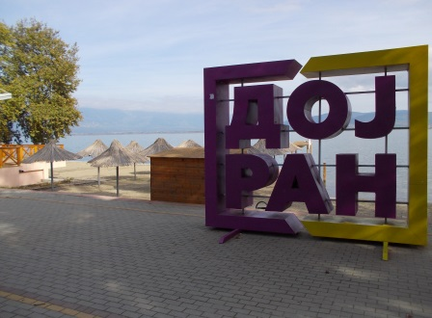
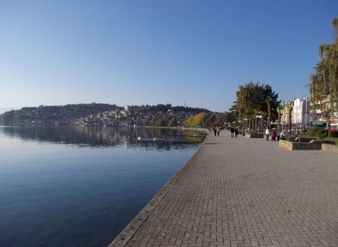
The most popular tourism destinations in North Macedonia are currently located at the lakes
Lake destinations
1
Lake Ohrid
2
Lake Prespa
3
Lake Dojran
3
1
2
Supply and demand
In absence of an access to the sea, the three biggest lakes of North Macedonia – Lake Ohrid (248 km² belonging to North Macedonia), Lake Prespa (176 km²) and Lake Dojran (27 km²) – are already visited by a large number of tourists every year
Destinations like Struga and Ohrid (at Lake Ohrid) or Star Dojran (Lake Dojran) are popular holiday destinations with a touristic supra- and infrastructure
All three lakes are situated directly at the boarder – Lake Ohrid belongs to North Macedonia and Albania, Lake Prespa to North Macedonia, Albania and Greece and Lake Dojran to North Macedonia and Greece
The lakes have different characteristics regarding size, depth, access, population, etc.
The most developed lakeside is at Lake Ohrid with a large number of tourism supra- and infrastructure facilities, followed by Lake Dojran. Lake Prespa is the least developed one.
Demand is mainly generated during the summer months – Lake Ohrid as currently the only one generating significant international demand.
Current level of attractiveness
Lake Ohrid is one of the tourism highlights of North Macedonia and an UNESCO World Heritage site.
Also Lake Dojran attracts significant numbers of tourists during the summer months and improved its attractiveness recently. Lake Prespa, as the least developed one, is only of limited attractiveness for visitors at the moment.
Source: Google maps, Kohl & Partner

Slide 51
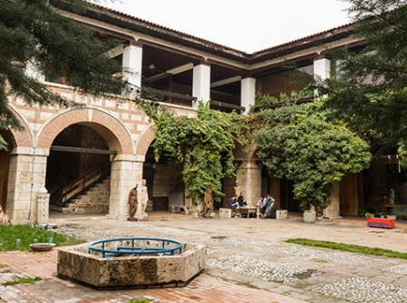
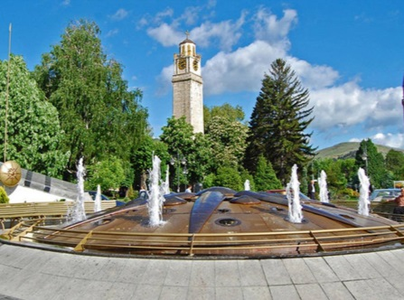
Skopje has the potential to become an attractive destination for city tourism
Cities
3
1
5
1
Skopje
2
Bitola
3
Kumanovo
4
Prilep
4
5
Tetovo
2
Supply and demand
With the capital Skopje (around 470.000 inhabitants) North Macedonia currently has only one larger city
All other cities of North Macedonia have less than 100.000 inhabitants with Bitola (75.000) being the second largest city, followed by Kumanovo (71.000)
Bitola is one of the oldest cities on the territory of the Republic of North Macedonia as it was founded in the middle of the 4th century BC - during the Ottoman rule the city was the last capital of Ottoman Rumelia
Tetovo is the door to the Sar Mountains and a lively city, due to its universities
Prilep is the marble and tobacco capital of North Macedonia
Skopje has a growing number of accommodation facilities in different categories and – also thanks to the project “Skopje 2014” – many sights. Also the other cities have some interesting sights (e.g. city centres, religious sights) but on a smaller scale.
Demand in all cities is currently mainly business driven.
Current level of attractiveness
The city centre of Skopje is already an attractive place for tourists with a lot of different sights (main square, old bazaar, Memorial House Mother Teresa, etc.) and the potential to become an attractive city weekend break destination.
Also the other larger cities have interesting places and sights for tourists, but more on a one-day visitor level.
Source: Google maps, www.North Macedonia-timeless.com

Slide 52
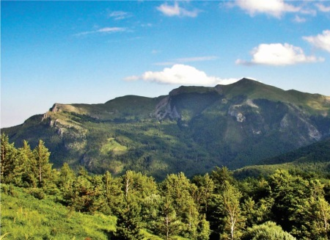
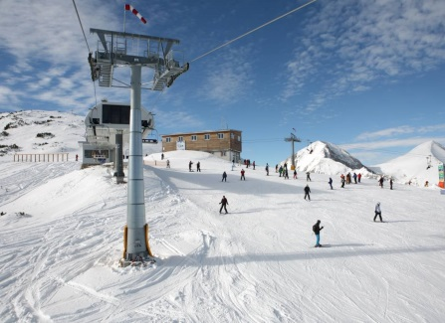
Currently North Macedonia has several smaller Mountain Resorts, mainly situated in the Western part of the country
Mountain destinations
1
1
Popova Shapka
2
Mavrovo
2
3
Krusevo
3
4
Kopanki/Pelister
5
5
Kozuf
4
Supply and demand
In many countries attractive and successful tourism destinations have been developed in the mountain regions
The main travel motives for visitors of mountain resorts are activities like skiing/snowboarding, hiking, biking or enjoying nature
North Macedonia currently offers several places with a skiing infrastructure – the biggest ones being Popova Shapka and Mavrovo, both situated in the Western part of the country) with several ski lifts and slopes
There are also some smaller skiing areas with only a few lifts (like the ones in Krusevo, Kopanki or Kozuf near the Greece boarder)
At the current stage, the North Macedonian Mountain Resorts mainly consists of some ski lifts/slopes and different accommodation facilities in the near surrounding. For the summer time hiking trails are often available.
Mountain Resorts are currently mainly visited by local tourists (North Macedonia/neighbouring regions) – often as a one-day visit.
Current level of attractiveness
Although often situated in scenic and high altitude locations the majority of the North Macedonian Mountain Resorts are currently only of average attractiveness.
The main reasons for this evaluation are outdated ski lifts, low quality of slope preparation, missing summer and entertainment facilities and unsolved ownership structures.
Source: Google maps, www.North Macedonia-timeless.com

Slide 53
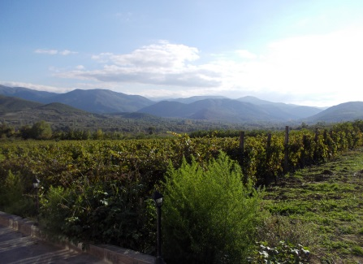
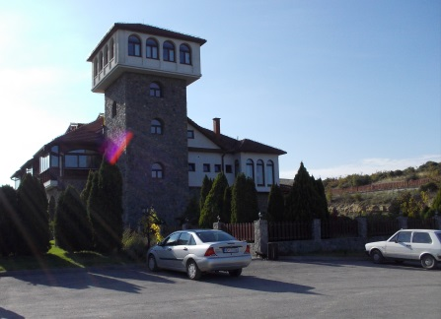
Wine tourism in the main wine-growing area of Vardar Valley is currently in its initial phase
Wine destinations
1
Povardarje -Vardar Valley
1
Other locations with vineyards
Supply and demand
Due to its geographic position and the favourable climatic conditions North Macedonia has a long history of wine production
There are several dozens of commercial wineries all over North Macedonia and vineyards can be found in almost all parts of the country
Around 85 % of the produced North Macedonian wine comes from the Vardar Valley around the towns of Kavadartsi and Demir Kapija
Well-known wines include Stanushina, Smederavka, Prokupec, Vranec and Temjanika
The biggest winery of North Macedonia (Tikvesh) is located in Kavadartsi
The local wineries realized the economic potential of wine tourism and started to create tourism products (e.g. wine tasting, restaurants, guided tours). It is more a product for one-day visitors, mainly due to a lack of accommodation facilities.
There is a growing demand for wine tourism products – the majority of the visitors are currently North Macedonians.
Current level of attractiveness
The leading wineries in the Vardar Valley have already created very attractive tourism products (e.g. excellent restaurant at Tikvesh winery or the restaurant/accommodation facility at Popova Kula winery) which should be the basis for the further development of this type of tourism in North Macedonia.
Also the landscape in this area can be classified as attractive.
Source: Google maps, Kohl & Partner

Slide 54
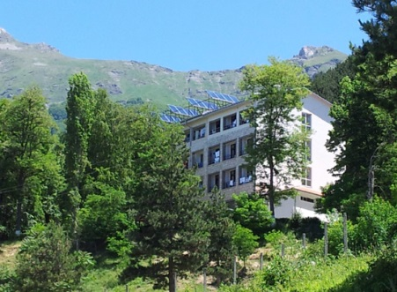
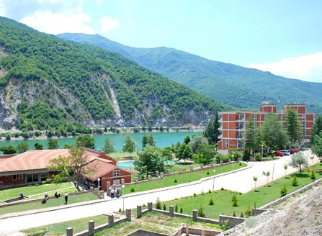
The hot water springs of North Macedonia are currently used mainly for medical treatments
Spa destinations
1
Bansko
6
2
Kezhovica
5
4
3
Negorci
2
4
Banja
8
5
Katlanovo
7
1
3
6
Proevska
7
Kosovrasti
8
Banjiste
Supply and demand
Several hot mineral water springs are currently used for health purposes in North Macedonia - the majority of them are located in the North-eastern and South-eastern part of the country
In majority of the cases a medical treatment centre including several accommodation units have been built around the hot mineral water springs
Like in many European spa destinations back in the 1980s the focus in the North Macedonian spa destinations is almost exclusively on medial treatments for people with certain illnesses
There is currently only a very limited amount of spa and wellness products offered at the majority of those spa destinations (with the exception of Banjiste)
Currently the spa destinations around the hot mineral water springs mainly consists of hospital-like accommodation facilities with medical treatment areas.
Visitors of those treatment centres are mainly North Macedonians, or North Macedonians living abroad, with certain illnesses wanting to improve their health condition.
Current level of attractiveness
The majority of the spa destinations are currently of very limited attractiveness for leisure travellers.
Although there is a growing market for spa and active holidays in many European countries, due to the mega trend of “health”, hardly any satisfying tourism products are currently available in North Macedonia.
Source: Google maps, www.North Macedonia-timeless.com

Slide 55
Main tourism attractions
National Tourism Strategy for North Macedonia

Slide 56
The majority of the top ranked sights at tripadvisor are either located in Skopje or at Lake Ohrid
Main tourism attractions
Top ranked tourism attractions in North Macedonia
Skopje
Lake Ohrid
Other
Lake Matka
Vodno
Church of St. Panteleimon
Old Bazaar
The Stone Bridge
North Macedonia Square
Millennium Cross
Holy Savior Church
Memorial House of Mother Teresa
Church of St. Clement of Ohrid
Museum of North Macedonian Struggle
Mustafa Pasha Mosque
National Archaeological Museum
St. Jovan Kaneo
Monastery of Saint Naum
Saint Sophia
Tsar Samuel‘s Fortress
Sveti Kliment Ohridski
National Workshop for Handmade Paper
Bay of the Bones Museum
Church of Our Lady Perivlepta
Plaoshnik
River Drim in Struga
National Park Galicica
Painted Mosque Sarena Dzamija (Tetovo)
Monastery St. Jovan Bigorski (Gostivar)
National Park Pelister
Heraclea (Bitola)
Shirok Sokak Street (Bitola)
As Skopje and Lake Ohrid are the most popular tourism destinations in North Macedonia, also the vast majority of the top ranked sights of North Macedonia are situated in those two destinations.
In general we can divide the current main tourism attractions of North Macedonia into two groups – natural attractions (like Lake Matka, Vodno or River Drim) and cultural sights (like churches, monasteries or museums).
Source: Tripadvisor

Slide 57
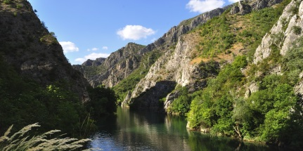
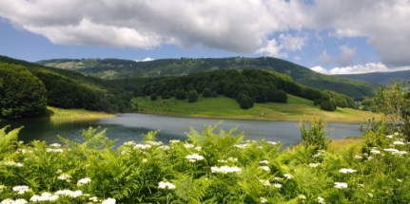
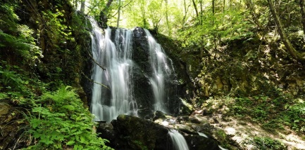
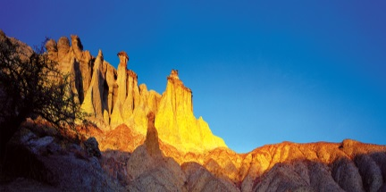
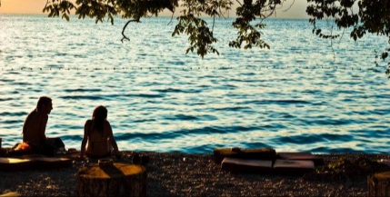
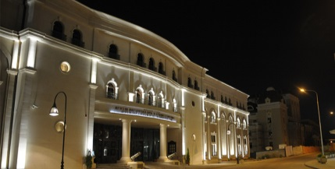
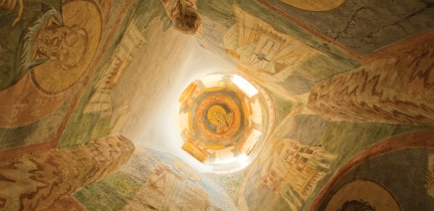
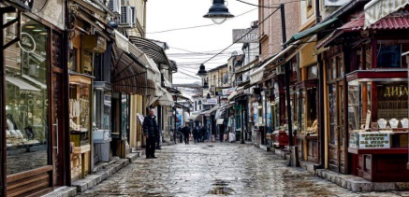
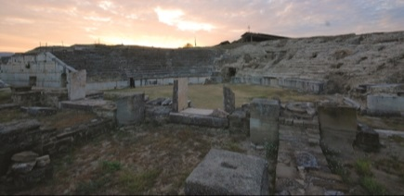
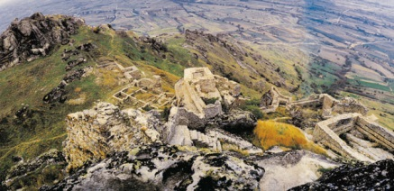
Also the shown attractions on the official national tourism website can be divided into natural and cultural sights
Main tourism attractions
Natural attractions
Caves (e.g. Peshna Cave, Vrelo Cave)
National Parks (Mavrovo, Pelister and Galichica)
Waterfalls (e.g. Koleshino Waterfall, Smolare Waterfall)
Natural monuments (e.g. Kuklici)
Beaches (e.g. at Lake Ohrid, Lake Dojran)
Cultural sights
Museums (e.g. Museum of North Macedonian Struggle)
Churches/mosques/ monasteries (e.g. Monastery of Saint Naum)
Historic city centres (e.g. Old Bazaar in Skopje)
Archaeological sites (e.g. Stobi, Kokino, Heraclea)
Historic buildings (e.g. Skopje Fortress, King Marko Towers in Prilep)
Source: www.North Macedonia-timeless.com

Slide 58
Analysis of the current situation
National Tourism Strategy for North Macedonia
Global tourism 17
Supply and demand analysis 22
Economic importance 35
Trend analysis 40
Main destinations and attractions 47
Framework conditions 58
SWOT-analysis 75

Slide 59
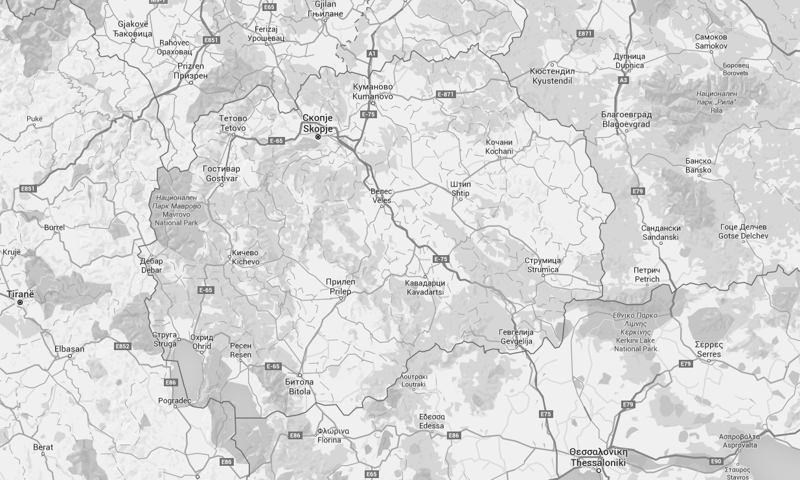
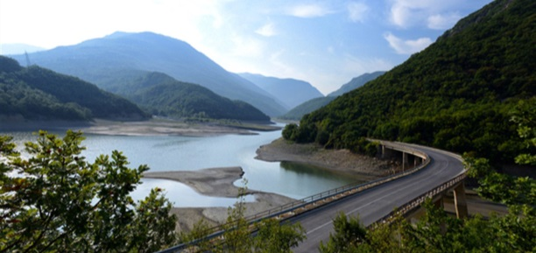
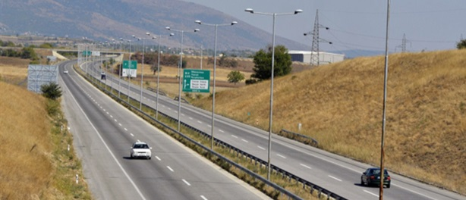
North Macedonia in general has a good road network and continues to improve it
Accessibility – road infrastracture
Road infrastructure
The road infrastructure, which is planned, managed and maintained by the Public Enterprise for State Roads, is well-developed in North Macedonia with a total length of more than 14.000 kilometres of motorways, national, regional and local roads
There are currently 242 km of motorways and a further enlargement of the motorway network is currently under construction (A 2 between Gostivar and Ohrid)
With the existing road infrastructure all parts of the country are easy accessible and the main roads are in general in a good shape, while local roads, especially to certain remote places, can be in a bad condition
A1
A2
A1
A1
Existing motorway
Planned motorway
Distance by car to major cities in the region
City | Distance to boarder | Distance to Skopje | Distance to Ohrid
Thessaloniki (Greece) | 80 km (1,00 h) | 230 km (2,75 h) | 285 km (3,75 h)
Sofia (Bulgaria) | 130 km (1,75 h) | 240 km (3,50 h) | 420 km (5,75 h)
Tirana (Albania) | 110 km (2,00 h) | 280 km (4,25 h) | 135 km (2,50 h)
Belgrade (Serbia) | 390 km (4,25 h) | 435 km (4,75 h) | 615 km (7,00 h)
Pristhina (Kosovo) | 65 km (1,00 h) | 90 km (1,50 h) | 250 km (3,75 h)
Niš (Serbia) | 170 km (2,25 h) | 215 km (2,75 h) | 390 km (5,00 h)
Source: Google Maps, www.roads.org.mk

Slide 60
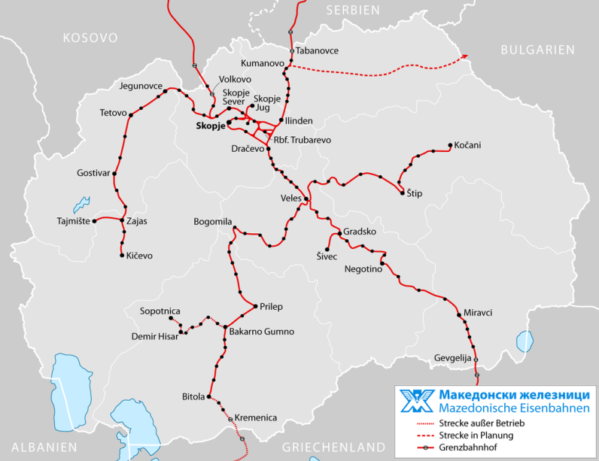

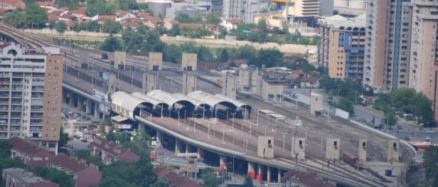
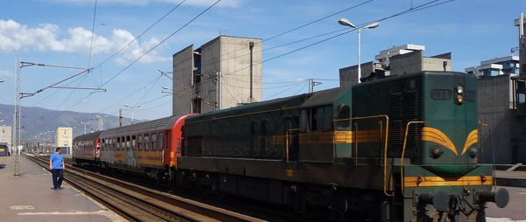
Trains are an inexpensive way to travel between the major cities in North Macedonia – no connection to Ohrid
Accessibility – train infrastructure
Train infrastructure
The North Macedonian train network has currently a total length of 925 kilometres, of which 315 are electrified, with 117 stations
Railway operations are run by Makedonski Železnici and the infrastructure is maintained by Makedonski Železnici – Infrastruktura
There are up to 22 daily train connections from Skopje to Kičevo, Bitola, Kočcani, Veles and Gevgelija - there are also 4 daily trains from abroad to Skopje (2x Belgrade – 9,5 hours, 1x Thessaloniki – 3,5 hours and 1x Pristhina – 3,0 hours)
The trains and stations are often outdated and not very well maintained – by the end of 2015 it is planned that new Chinese passenger trains will start operations to improve the travel experience
Existing routes
Planned routes
Train connections within North Macedonia
Route | Travel time (hours) | Daily frequency | Price one-way (MKD)
Skopje – Kičevo | 2,0 | 2 | 208
Skopje – Bitola | 3,0 | 4 | 314
Skopje – Kočani | 4,0 | 1 | 249
Skopje – Veles | 1,0 | 12 | 112,50
Skopje – Gevgelija | 2,5 | 3 | 277
Source: www.mztransportad.com.mk

Slide 61
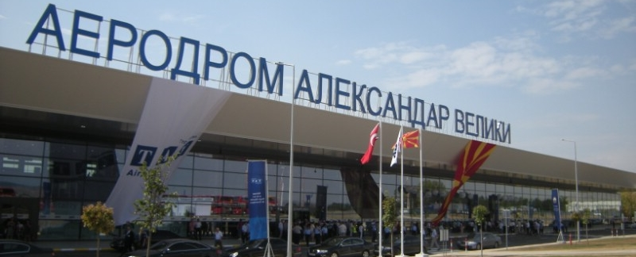
Skopje airport is currently the largest airport in North Macedonia with more than 1,4 million annual passengers
Accessibility - airports
Skopje airport
Skopje airport is located 17 kilometres Southeast of the capital and started operation in 1929
In 2008 the North Macedonian government signed a contract with the Turkish company TAV for a twenty-year-long concession for Skopje airport
In 2011 the new terminal building, a new access road and parking facilities were opened
There had been a significant increase in annual passengers at Skopje airport over the last couple of years reaching 1,4 million in 2015 (in 2014 more than 1 million passengers have been generated for the first time since the year 2000)
The Hungarian low cost carrier Wizz Air is using Skopje as one of their 20 bases and currently offers 19 destinations by operating direct flights to 10 countries
Departures (weekly)* | Destination
10 < | Vienna (11x Austrian), Zurich (1x Belair, 4x Edelweiss, 4x Helvetic, 3x Germania)
5 to 10 | Basel (5x Wizz Air), Belgrade (7x Air Serbia), Istanbul (7x Turkish, 3x Pegasus). Ljubljana (7x Adria), Malmo (6x Wizz Air), Rome (6x Alitalia), Zagreb (7x Croatia)
1 to 4 | Wizz Air: Barcelona (2x), Brussels (2x), Cologne (2x), Dortmund (3x), Eindhoven (2x), Frankfurt (2x), Friedrichshafen (2x), Gothenburg (3x), Hamburg (2x), London (4x), Milan (2x), Munich (3x), Nuremberg (2x), Oslo (2x), Paris (2x), Stockholm (2x), Venice (2x) Other airlines: Dubai (2x Fly Dubai), Dusseldorf (1x Germania), Geneva (1x Swiss)
Amount of annual passengers at Skopje airport (in 000)
Source: Skopje airport
* Winter schedule 2015/16

Slide 62

The second international airport of North Macedonia is located in Ohrid with around 108.000 passengers in 2015
Accessibility - airports
Ohrid airport
Ohrid airport is located 9 kilometres from the city of Ohrid and mainly serves as an airport for charter flights in the summer time
In 2008 the North Macedonian government signed a contract with the Turkish company TAV for a twenty-year-long concession for Ohrid airport
The apron can accommodate up to 9 aircrafts and the terminal is equipped to handle up to 400.000 passengers annually
For the majority of the years between 1997 and 2014 the amount of annual passengers was between 40.000 and 90.000 – in 2015 the airport reported more than 100.000 passengers for the first time
The Hungarian low cost carrier Wizz Air started to operate flights from Basel and London (each with 2 weekly flights) during their summer schedule of 2015 – additionally there are several direct summer charter flights from different European countries
Examplary prices for the Wizz Air flights to Ohrid*
London: April 2016 from EUR 61 May 2016 EUR 92 June 2016 EUR 92 July 2016 EUR 92 August 2016 EUR 157 September 2016 EUR 46 October 2016 EUR 55
Basel: April 2016 from EUR 65 May 2016 EUR 50 June 2016 EUR 60 July 2016 EUR 140 August 2016 EUR 40 September 2016 EUR 20 October 2016 EUR 40
Amount of annual passengers at Ohrid airport (in 000)
Source: Ohrid airport
* Cheapest available ticket - return flight staying one week (checked Nov 2015)

Slide 63















































































The visa policy of the Republic of North Macedonia is similar to the Visa policy of the Schengen Area
Visa policy
The citizens of European countries (except Belarus and Moldova) and of main global tourism source markets (like the US, Japan, Canada or Australia) do not need a visa to enter North Macedonia. Therefore the current visa policy can be described as favorable.
Countries not needing a visa when entering North Macedonia
Albania, Andorra, Antigua and Barbuda, Argentina, Australia, Austria, Azerbaijan, Bahamas, Barbados, Belgium, Botswana, Bosnia-H., Brazil, Brunei, Bulgaria, Canada, Chile, Costa Rica, Croatia, Cuba, Cyprus, Czech Rep., Denmark, El Salvador, Estonia, Finland, France, Germany, UK, Guatemala, Honduras, Hong Kong, Hungary, Iceland, Ireland, Israel, Italy, Japan, Kazakhstan, South Korea, Kosovo, Latvia, Liechtenstein, Lithuania, Luxembourg, Macau, Malaysia, Malta, Mauritius, Mexico, Monaco, Montenegro, Netherlands, New Zealand, Nicaragua, Norway, Panama, Paraguay, Peru, Poland, Portugal, Romania, Russia, St. Kitts and Nevis, San Marino, Serbia, Seychelles, Singapore, Slovakia, Slovenia, Spain, Sweden, Switzerland, Taiwan, Turkey, UAE, Ukraine, Uruguay, USA, Vatican and Venezuela
Source: Ministry of Foreign Affairs

Slide 64
There are eight key stakeholders of tourism on a national level in North Macedonia
Key stakeholders – national level
Ministry of Economy (tourism department)
Agency for Promotion and Support of Tourism
The tourism department within the Ministry of Economy is currently responsible for the tourism policy/strategic planning and licensing, research, categorization and cooperation.
Currently 11 people are employed - five dealing with tourism policy/strategic planning and four with the other areas (plus one Head of Department and one Advisor).
The annual budget for the tourism department had been MKD 9,9 million in 2013, MKD 8,6 million in 2014 and had been increased to MKD 23,2 million in 2015 – the same budget could be available also for 2016.
The Agency for Promotion and Support of Tourism was founded in 2007 and is a government organization whose primary function is the promotion of North Macedonian tourism resources and facilities abroad.
Currently 35 people, all working at the headquarter in Skopje, are employed - there are currently no offices abroad nor are TICs (Tourist Information Centers) run by the agency.
The annual budget for the agency had been MKD 204 million in 2015, MKD 209 million in 2014 and MKD 142,3 million in 2013 - an increase to around MKD 270 million is expected for 2016.
HOTAM
Tourism Chamber (North Macedonian Chamber of Commerce)
HOTAM is a voluntary association of hotel and catering businesses in North Macedonia. It is a non profit and non government organization, however members are required to pay a small annual fee. All collected funds are used to cover the expenses, to promote and protect the members.
Currently the association has 67 members – 50 hotels (the majority of them at Lake Ohrid), 3 camping sites, 2 private accommodation facilities, 3 tourism education institutes, 6 restaurants and 3 tour operators.
The Tourism Chamber within the North Macedonian Chamber of Commerce is working towards the promotion of tourism potential and development of cultural tourism in North Macedonia.
It was founded in 2008 and is the sixth chamber within the North Macedonian Chamber of Commerce.
Source: Personal interviews

Slide 65
There are eight key stakeholders of tourism on a national level in North Macedonia
Key stakeholders – national level
Chamber of Tourism of North Macedonia
Economic Chamber of North-West North Macedonia
The Chamber of Tourism of North Macedonia is an independent, autonomous and non-profit business and professional organization of legal and individual professionals from the Republic of North Macedonia performing business in the tourism industry such as catering, hotel, transportation, tourist services, tourism education and other specified activities, aimed to develop and successfully implement tourism products.
The members are organized on a professional guild base and their membership is in accordance with the law on chambers of commerce.
The Economic Chamber of North-West North Macedonia (ECNWM), as a legitimate representative of the interests of the business community, aims at supporting the organization, improvement, promotion and protection of businesses both within the Republic of North Macedonia and abroad by conquering the challenges of the competition at different levels – locally or internationally.
Based on professionalism, high working standards, determination, flexibility, transparency, consistency and equal approach, ECNWM significantly supports the promotion of the businesses as well as societies towards the European values.
North Macedonian Tourist Chamber
Catering Industry and Tourism Association at the Economic Chamber of North Macedonia
The North Macedonian Tourist Chamber (TCM) is a non-profit organization. It unites, on a voluntary basis, national, regional and local brand organizations and councils, companies from the hotel and restaurant business, tour operators and tour agents, companies and organizations related with the tourism industry and fully capable persons.
TCM was founded in 2008. It is the first non-government trade and tourism organization in North Macedonia. TCM performs the functions with the purpose to coordinate, organize and manage joined activities in the North Macedonian tourism industry.
Source: Personal interviews

Slide 66

North Macedonia is administratively divided into 80 municipalities and 8 statistical regions with RDCs have been defined
Organizational structures
80 municipalities
8 statistical regions
The municipalities of the Republic of North Macedonia are first-order administrative divisions. 10 of the municipalities constitute the City of Skopje or Greater Skopje.
By law the municipalities have to collect the tourism tax of MKD 40 per overnight and 80 % of the collected tourism tax remains at the municipality. The municipality has to use this money for tourism-related activities (tourism development and marketing).
Overall the financial resources for tourism development are very limited in the municipalities, although certain initiatives (often donor financed) have been started.
The country is also divided into 8 statistical regions – Polog, Skopje, Northeastern, Eastern, Southwestern, Pelagonia, Vardar and Southeastern.
In each statistical region there is a Regional Development Center (RDC). They prepare strategic documents, conduct research and support the local municipalities to prepare and hand in projects at a national level in Skopje. They often also have a tourism strategy.
The RDCs also have very limited financial resources, as they are financed by the municipalities with MKD 10 per year per inhabitant. They also try to initiate donor-based projects.

Slide 67
The tourism department of the Ministry and the Agency for Promotion had a common budget of MKD 227 million in 2015
Financial resources in tourism
Financial resources in tourism 2015
Tourism Department (Ministry for Economy)
MKD 23,1 million
In 2015 the tourism department within the Ministry for Economy had a budget of MKD 23,1 million – this represented an significant increase, as in the two previous years the annual budget was MKD 9,9 million in 2013 and MKD 8,6 million in 2014
Projects that had been financed with this budget included some studies (e.g. “Water-related tourism”, “National Strategy” or “Planning of Old Bazaar renovation”), a software for improving tourism statistics and the planning and installing of new tourism signage in Ohrid and Bitola
The Agency for Promotion and Support had a budget of MKD 204 million in 2015 – a slightly lower amount in comparison to the previous year
Approximately MKD 141 million (69 %) had been reserved for the subsidy program to support the national tour operators , MKD 38 million (19 %) for marketing and promotion activities, MKD 25 million (12 %) for tourism development support
Based on national law each municipality is obliged to collect MKD 40 per overnight from the accommodation facilities – in 2014 there had been 2.196.000 overnights in North Macedonia, which would lead to an income from tourism tax of approximately MKD 88 million
With their share of 80 % of the tourism tax income, the most popular tourism municipality of Ohrid, for example, should have generated MKD 24,1 million in 2014
Agency for Promotion and Support
MKD 204 million
Tourism tax
MKD 88 million*
Source: Ministry for Economy, Agency for Promotion
* Assumption based on the official number of annual overnights in 2014

Slide 68
The annual marketing budget of the Agency is currently below the level of comparable countries
Financial resources in tourism
Country | Annual total budget of NTO (local currency) | Annual total budget of NTO (EUR 000) | Annual international arrivals (000) | Annual total budget per int. arrival (EUR)
North Macedonia* | MKD 63.000.000** | 1.032 | 425 | 2,43
Croatia | HRK 328.380.000 | 43.052 | 11.623 | 3,70
Serbia | RSD 461.772.000 | 3.834 | 1.029 | 3,73
Slovenia (2012) | EUR 10.636.000 | 10.636 | 2.156 | 4,93
Slovakia | EUR 7.847.000 | 7.847 | 1.450 | 5,41
Czech Republic | CZK 747.147.000 | 27.654 | 8.096 | 3,42
Bulgaria (ministry) | BGN 13.000.000 | 6.684 | 9.409 | 0,71
Country | Annual marketing budget of NTO (local currency) | Annual marketing budget of NTO (EUR 000) | Annual international arrivals (000) | Annual marketing budget per int. arrival (EUR)
North Macedonia | MKD 38.000.000 | 623 | 425 | 1,47
Croatia | HRK 177.000.000 | 23.206 | 11.623 | 2,00
Serbia | RSD 335.751.000 | 2.788 | 1.029 | 2,71
Slovenia (2012) | EUR 8.166.000 | 8.166 | 2.156 | 3,79
Slovakia | EUR 4.865.000 | 4.865 | 1.450 | 3,36
Czech Republic | CZK 597.717.000 | 22.123 | 8.096 | 2,73
Bulgaria (ministry) | BGN 9.000.000 | 4.628 | 9.409 | 0,49
Source: websites of the respective NTO ** Without the money allocated for the tour operators
* In North Macedonia the Agency for Promotion and Support of Tourism is acting as an NTO

Slide 69
Currently accommodation facilities in North Macedonia have to charge a VAT of 5 % - one of the lowest rates in Europe
Financial resources in tourism
VAT rates for accommodation facilities
10 %
8 %
12 %
9 %
18 %
12 %
25 %
9 %
9 %
20 %
20 %
6 %
8 %
6 %
7 %
20 %
3 %
15 %
20 %
10 %
13 %
18 %
3,8 %
9,5 %
9 %
10 %
13 %
17 %
10 %
18 %
9 %
7 %
10 %
5 %
8 %
6 %
20 %
6 %
9 %
7 %
Source: www.ec.europa.eu, www.hrs.com

Slide 70
North Macedonia introduced a tourism tax similar to the one of Slovenia and Croatia
Financial resources in tourism
North Macedonia
Tourism tax of MKD 40 (EUR 0,66) per adult per overnight
Based on national law each municipality is obliged to collect the tourism tax from their accommodation facilities
80 % of the collected tourism tax remains at the municipalities - they are obliged to use it for tourism promotion or improvements for the tourism industry – 20 % has to be transferred to the Ministry of Finance
Slovenia
Tourism tax between EUR 0,60 and EUR 1,25 per person per overnight (depending on the location and the type of accommodation facility)
The municipalities are collecting the tourism tax from the accommodation facilities
In 2013 the Slovenian municipalities collected around EUR 8,2 million of tourism tax
Austria
The majority of the Austrian provinces have three different types of tourism tax (visitor’s tax per arrival, overnight tax and tourism tax for every company)
The amount of visitor’s tax and overnight tax differs from province to province – in Carinthia, for example, visitor’s tax has to be between EUR 0,36 – 2,00 per arrival (determined by the municipalities) and overnight tax is EUR 0,50 per overnight (determined by the province)
In Carinthia visitor’s tax and overnight tax are collected by the municipalities – the tourism tax for companies by the province
From the visitor’s tax 45 % goes to the regional DMO and 50 % to the local tourism associations – from the overnight tax 90 % to the provincial DMO – from the tourism tax 35 % to the provincial DMO, 30 % to the regional one and 30 % to the local tourism associations
Croatia
Sojourn tax of HRK 2 – 7 (EUR 0,26 – 0,92) per adult per overnight depending on destination and season
65 % to tourism board of municipality/city (30 % of this amount to administration of municipality/city for tourism development projects) – 10 % to county tourism board – 25 % to National Tourism Organization
Different distribution for municipalities/cities with a low annual income from sojourn tax or without tourism boards
A study conducted in 2014 by HOTREC showed, that in 18 out of the analyzed 31 European countries, a certain tourism tax has been introduced.
Out of those 18 countries 14 have, at the same time, a reduced VAT rate for accommodation facilities.
The 13 countries of the analysis not having introduced a tourism tax include Turkey, Sweden, Portugal, Ireland, Greece or Cyprus.

Slide 71
There are currently two main subsidy programs with a direct effect on the tourism industry in North Macedonia
Subsidies
Subsidies for tour operators / travel agencies
Subsidies for Low Cost Carriers (LCCs)
In 2011 the government started a subsidy program for North Macedonian tour operators and travel agencies to increase the competitiveness of the offered North Macedonian holiday packages and, as a consequence, to increase the demand for leisure holidays in the country.
In 2015 around MKD 91 million (approximately EUR 1,5 million) have been allocated in the budget of the Agency for Promotion and Support for tour operator subsidies.
Subsidies are only granted if certain pre-defined conditions are fulfilled by the holiday package: e.g. minimum stay of three nights with breakfast at an accommodation facility with professional services. Subsidies are granted for bus transportation, air transfer, charter transport, railway transport, combined transport and tour trips.
Example: Flight transportation subsidies (in EUR per passenger):
EUR 65 for Belgium, Netherlands, Luxembourg, Finland, Norway, Denmark, Sweden, Russia, Ukraine, UAE and Japan
EUR 45 for intercontinental destinations
EUR 25 all other European countries
The other subsidized activities (besides air and charter transfer) receive between EUR 10 and EUR 25 of subsidies per passenger.
In absence of a national airline, the North Macedonian Government issued an international tender to European LCCs in 2012 which included an offer of subsidies to cover new services for the next three years.
Wizz Air responded and launched six new routes subsidized by the North Macedonian Government at the start of the winter 2012/2013 schedule.
In December 2014 the responsible Ministry for Transport and Communication announced to spend another EUR 5 million over the next three years for subsidizing flight connections to Skopje and Ohrid.
Again Wizz Air won the tender and introduced several new connections to Skopje and Ohrid starting from 2015.
The financial support for the new flights includes a lump sum of EUR 40.000 for each new destination launched and an additional EUR 13 for each departing passenger in the first year of operations, EUR 12 in the second and EUR 11 in the third year of operations.
Those subsidies have an effect on the tourism industry in the country – on one hand it is possible to reach North Macedonia at a competitive price, which offers great potential for incoming tourism, on the other hand it also allows North Macedonians to travel to tourism destinations abroad relatively easy and inexpensive.
Source: HOTAM, Ministry of Transport and Communication

Slide 72




In 2013 the North Macedonian government has defined nine special tourism development zones
Tourism Development Zones
In order to stimulate investment in the tourism industry, the government in North Macedonia has defined nine special tourism development zones
Seven of those zones are located at lakes (one at Lake Dojran, four at Lake Ohrid and two at Lake Prespa) and two in the mountains (Shar Planina and Kozuf)
All zones have in common, that they are greenfield development areas and that the land belongs to the state
Investors interested in those zones receive special fiscal benefits (e.g. 0 % personal income tax for the first 10 years or 0 % VAT) and the complete infrastructure towards the boundaries of the TDZ will be provided by the government
The Agency for Promotion and Support, together with the National Investment Agency, is responsible for the promotion of the zones
Examples: Development Concepts for the two Tourism Development Zones of Star Dojran and Kalista
Source: Spatial Planning Agency of North Macedonia, Agency of Promotion

Slide 73
In 2015 the Agency for Promotion and Support had a budget of MKD 38 million for tourism marketing activities
Tourism marketing
1,5 % - Mobile and online software programs (MKD 580.000)
Preparation, printing and distribution of promotion material (MKD 4 million)
Promotion campaigns like bilboards, advertisements, TV promotion, etc. (MKD 9,2 million)
Information campaigns abroad and info tours for tour operators and journalists in North Macedonia (MKD 4 million)
Participation in international, regional and local fairs (MKD 20 million)
More than half of the available annual marketing budget for 2015 had been allocated for participating in tourism fairs – it was planned to be present at the fairs in Utrecht, Istanbul, Brussels, Sofia, Belgrade, Berlin, Moscow, London, Gothenburg, Helsinki, Tokyo, Cologne, Rimini, Madrid, Paris and Skopje
Around one quarter of the budget had been allocated for promotion campaigns in Serbia, Slovenia, Croatia, Bulgaria, Albania, Kosovo and France
Around MKD 4 million had been allocated for promotion material, which was planned to include 6 different themes in 11 languages
Another MKD 4 million had been allocated for information campaigns abroad and info tours in North Macedonia
The remaining 1,5 % were supposed to be used for mobile and online software programs

Slide 74


Middle and higher education in tourism is offered in different North Macedonian educational institutions
Tourism education
Middle education in tourism
Higher education in tourism
Only a few schools in North Macedonia currently offer middle education in tourism. One example is the Catering & Tourism School “Vanco Pitosheski” in Ohrid. This school was founded in 1960 and has around 500 students. The school is authorized to carry out examinations for several occupations like waiters, chefs, chambermaids or bartenders.
The annual program is prepared by the school in cooperation with the Ministry of Education and Science. The school lasts for three or four years, depending on the chosen specialization and includes vocational training during the summer holidays.
Similar secondary schools offering tourism education exist in other bigger North Macedonian cities (e.g. Skopje or Tetovo).
One of the current weaknesses is the often weak reputation of tourism-related jobs among the population, which as a consequence leads to a higher number of students choosing this kind of education due to missing alternatives.
There are currently five universities (private and public ones) in North Macedonia offering higher educational programs in the field of tourism:
Economic faculty at Tetovo University
Tourism faculty at MIT University in Skopje
Tourism faculty at Sv. Kliment University in Ohrid
Tourism and business logistic faculty at Shtip University
Tourism faculty at the University for Tourism and Management in Skopje
Usually a 3+2 model with six semesters of undergraduate studies and four semesters of graduate studies are implemented. In the first six semesters the main principles of the tourism industry are taught, while in the graduate studies the students often specialize. Practical experience is often gained by the students through internships, as part of their studies.
Source: utms.edu.mk, nnb.edu.mk, vancopitoseski.edu.mk

Slide 75
Analysis of the current situation
National Tourism Strategy for North Macedonia
Global tourism 17
Supply and demand analysis 22
Economic importance 35
Trend analysis 40
Main destinations and attractions 47
Framework conditions 58
SWOT-analysis 75

Slide 76
SWOT analysis
Main strengths
Main weaknesses
The existing attractiveness for tourists of Skopje and Ohrid as the touristic highlights of the country
Existing flight connections of Low Cost Carriers to Skopje and Ohrid
Airports in both of the two most visited tourism destinations of North Macedonia (Skopje and Ohrid)
Short distances between the different destinations and attractions
Motivated incoming tour operators due to the existing subsidy program
Increasing number of overnights by foreigners within the last couple of years
Visa free entrance for the majority of the important source markets for North Macedonian tourism
Natural resources (mountains, lakes) and cultural heritage
North Macedonia is still a relatively unknown tourism destination outside the region
High seasonality in the main leisure destinations
Low amount of direct flight connections to Ohrid
Limited financial and human resources within the tourism department of the Ministry for Economy
Low annual marketing budget in comparison to other countries
Decreasing number of overnights by domestic travellers within the last couple of years
Weak organizational structures below the national level
Limited amount of appropriate accommodation facilities outside the main tourism hubs
Weak tourism product development on a regional / local level due to a lack of know-how and of financial resources
Lack of coordination of the various tourism-related activities on a national, regional and local level
No subsidy program for tourism accommodation facilities or tourism attractions
No Tourism Satellite Account and irregular visitor surveys
Grey market of private accommodation facilities
Educational standards in tourism are often low – the same applies to the service quality
Poor quality of some tourism facilities (e.g. spas, camping grounds)
S
W
Source: Kohl & Partner

Slide 77
SWOT analysis
Main opportunities
Main threats
Proximity to strong tourism outbound markets like Germany or Italy
Increasing interest in individual travel
Due to experienced travellers there will be a growing demand for new tourism destinations
Benefiting from the transit visitors driving through North Macedonia
Lake Ohrid has the potential to become one of the most popular tourism destinations in Southeastern Europe
Skopje as the potential to become one of the most popular city break destinations in Southeastern Europe
Positive development in tourism will lead to an increasing income from the tourism industry for private entrepreneurs and the public administration, will create new jobs and will stimulate additional investment
Development of attractive tourism products in the surrounding area of existing tourism hubs (e.g. the lake destinations or Skopje)
Make use of the new flight connections offered by LCCs by promoting North Macedonia as an attractive place to visit in those markets
Use the further approach towards the EU for the development of business tourism
A positive development of tourism often also has a positive effect on the overall image of a country
Low Cost Carriers decide to reduce the number of flight connections
Political and economic instability
Faster and more professional development of tourism in competing neighbouring countries
Uncoordinated development
Insufficient financial resources for tourism development and tourism marketing from the public side
The available financial resources for tourism development are not used in the most effective way
Missing concentration on the most important projects, which will really move forward the tourism industry in the country
Insufficient organizational structure within the public administration
North Macedonia will remain having the image of “just another of those Balkan countries” outside the region
Global crises (e.g. terrorism, refugees)
O
T
Source: Kohl & Partner

Slide 78
Table of contents (TOC)
National Tourism Strategy for North Macedonia
1. Evaluation of the National Strategy 2009 - 2013 4
2. Analysis of the current situation 16
3. Tourism development strategy 78
4. Action plan 2019 - 2021 109

Slide 79
Tourism development offers various benefits for a destination
Benefits of tourism development
Social benefits
Supports the development of communities
Improves the infrastructure and living standards
Increases an environmentally conscious behavior
Contributes to the perception of the country in the global market
Economic benefits
Poverty alleviation
Generates income that can be used for environmental protection
Increased contribution to GDP
Trade surplus
Acts as an catalyst for peace through cultural exchange between hosts and guests
Revenue source
Multiplier effects
Foreign exchange
earnings
Environmental benefits
Stimulation of
investment
Political benefits
Comparative value
Supports the protection, conservation and restoration of biological diversity
Employment generation
Cultural benefits
Boots the recovery, preservation and transmission of cultural and historical traditions
Helps raise the awareness of the local population regarding the value of natural and cultural sites
Stimulates the pride on local and national heritage

Slide 80

Vision
Vision Tourism in North Macedonia 2030
North Macedonia is a recognized tourism destination among Europeans. The number of overnights by foreigners continuously increased since 2015 and the decline of overnights by domestic travellers, which had been registered between 2010 and 2015, had been stopped and remained stable.
Guidelines
S
i
t
u
a
t
i
o
n
C
u
r
r
e
n
t
Strategy F
Strategy E
Strategy D
Strategy A
Powerful
Vision
Strategy B
Strategy C
Guidelines

Slide 81
Estimated development of overnights
Realistic scenario*
Assumptions:
A significant number of the actions recommended in this National Tourism Strategy has been implemented by the government
The overall economic situation of North Macedonia allows the government to continuously increase the amount of public financial resources for tourism development and marketing
Overnights (000) | 2015 | 2021 | 2030 | CAGR*
Domestic | 1.358 | 1.500 | 1.800 | 1,9 %
Foreign | 1.036 | 1.600 | 3.400 | 8,2 %
Total | 2.394 | 3.100 | 5.200 | 5,3 %
Optimistic scenario*
Assumptions:
The majority of the actions recommended in this National Tourism Strategy has been implemented by the government
The overall economic situation of North Macedonia allows the government to continuously increase the amount of public financial resources for tourism development and marketing significantly
Overnights (000) | 2015 | 2021 | 2030 | CAGR*
Domestic | 1.358 | 1.600 | 2.000 | 2,6 %
Foreign | 1.036 | 1.800 | 4.100 | 9,6 %
Total | 2.394 | 3.400 | 6.100 | 6,4 %
Pessimistic scenario*
Assumptions:
Only a limited number of the actions recommended in this National Tourism Strategy has been implemented by the government
The overall economic situation of North Macedonia does not allow the government to continuously increase the amount of public financial resources for tourism development and marketing
Overnights (000) | 2015 | 2021 | 2030 | CAGR*
Domestic | 1.358 | 1.400 | 1.400 | 0,2 %
Foreign | 1.036 | 1.300 | 1.800 | 3,8 %
Total | 2.394 | 2.700 | 3.200 | 2,0 %
* Not taking into consideration potential force major (e.g. political instability, new global crisis, etc.)

Slide 82












There are 12 main types of tourism generating substantial demand worldwide – several further niche types also exist
Types of Tourism
Sun & Beach Tourism
City Tourism
Culture Tourism
Cruise Tourism
Business/MICE Tourism
Health & SpaTourism
Mountain / Winter Tourism
Lake Tourism
Adventure Tourism
Nature/Eco Tourism
Pilgrimage Tourism
Visiting Family/Friends

Slide 83
In order to develop a certain type of tourism the destination needs to fulfill specific pre-conditions
Types of Tourism
Sun & Beach Tourism
City Tourism
Culture Tourism
Cruise Tourism
Sea access
Maintained and accessible beaches
Suitable climatic conditions
Large number of sights and events
Attractive and maintained city centre
Attractive shopping possibilities
Important historic and cultural places
Cultural events
Museums dedicated to culture
Sea access or navigable rivers
Appropriate port with landing stage
Interesting attractions near the port
Business/MICE Tourism
Health & Spa Tourism
Mountain & Winter Tourism
Lake Tourism
Large number of national and international companies
Several specific congresses, conferences or fairs
Significant amount of MICE facilities
Existence of thermal or mineral water
Medical treatment and spa offer
Manifold sport and activity possibilities
Attractive mountain range
Easy accessibility year round
Suitable climate
Clean water, ideally of drinking water quality
Suitable climate
Accessible lakeside with public beaches
Corresponding accommodation facilities and tourism attractions
Adventure Tourism
Nature/Eco Tourism
Pilgrimage Tourism
Visiting Family & Friends
Several extraordinary adventure tours
Existence of special/mystic places
Unusual locations
Natural and unspoilt landscape
Intact flora and fauna
Traditional culture and way of living
Organic food
Religious places and buildings
Mystic and spiritual places
Important historic events
No specific pre-conditions

Slide 84
In order to attract more foreign leisure travelers North Macedonia should focus on city, culture and lake tourism
Types of Tourism
 | General conditions | Current situation | Potential (domestic) | Potential (regional) | Potential (international)
Sun & Beach Tourism
City Tourism
Culture Tourism
Business/MICE Tourism
Health & Spa Tourism
Mountain/Winter Tourism
Adventure Tourism
Nature/Eco Tourism*
Pilgrimage Tourism
Cruise Tourism
Lake Tourism
Visiting Family & Friends
-
+
~
+
+
+
+
+
+
~
~
+
+
+
~
-
+
+
+
~
-
+
+
+
-
+
~
+
+
~
~
-
+
+
~
+
~
+
+
~
~
-
~
~
-
-
+
+
+
+
+
+
+
+
+
Very good
+
Good
~
Average
-
Poor
* Including wine tourism

Slide 85




It is recommended to base the future positioning of North Macedonia regarding tourism on four main pillars
Positioning
The future positioning should be based on the following pillars:
Skopje
Skopje, the capital of North Macedonia, already offers several interesting places and sights for tourists and can already be described as an attractive city break destination.
At the same time it is easy and inexpensive to reach, due to the growing number of LCC flight connections.
Skopje
Lake Ohrid
Lake Ohrid
Lake Ohrid is one of the tourism highlights of North Macedonia, an UNESCO World Heritage site and already a developed tourism destination.
46 % of all registered overnights of North Macedonia are generated at Lake Ohrid (municipalities of Struga and Ohrid).
North Macedonian culture
Nature experience
North Macedonian culture
Due to its history, North Macedonia is rich in historic sights but also the younger contemporary history and the current lifestyle is an important part of the North Macedonian culture.
This also includes traditional North Macedonian cuisine, typical products, North Macedonian festivals but also North Macedonian wine.
Nature experience
North Macedonia is also rich in nature. This can be experienced at the lakes but also in the mountains or near hot mineral water springs.
Part of the nature experience are also the National Parks, the caves or the waterfalls.
Source: www.North Macedonia-timeless.com

Slide 86
Eight key development strategies have been defined to support a professional tourism development in North Macedonia
Strategic targets
1
Improve the awareness of North Macedonia as an attractive tourism destination abroad
2
Improve the attractiveness of North Macedonia as a tourism destination
3
Improve the organizational structures in tourism
4
Improve the investment climate for North Macedonian entrepreneurs regarding the development of additional accommodation facilities
5
Improve the quantity and quality of available data in tourism
6
Improve the framework conditions for tourism development
7
Improve tourism know-how and service quality
8
Improve the tourism awareness of the local population

Slide 87




Strategic targets
1
Improve the awareness of North Macedonia as an attractive tourism destination abroad
Current situation
Currently North Macedonia is still a relatively unknown tourism destination among the majority of the Europeans. That North Macedonian destinations like Skopje and Ohrid are already attractive tourism destinations is also not known.
The subsidy program of the North Macedonian government for the tour operators has a positive effect on the awareness of North Macedonia as an attractive tourism destination, as strong international tour operators started to include North Macedonia in their programs and, as a consequence, also promote it as a holiday destination.
Also the Agency for Promotion and Support implements several marketing activities to improve the awareness of North Macedonia as an attractive tourism destination abroad. But the available financial resources (e.g. MKD 38 million in 2015) for marketing activities limit the possibilities.
Especially when comparing the available annual marketing budget of the agency with other European countries it is obvious, that the available annual financial resources for tourism marketing in North Macedonia are currently very limited.
Recommendation
It is recommended to increase the amount of available marketing budget at the Agency for Promotion and Support to a comparable level of other countries. The main indicator should be the available annual marketing budget per international arrival.
In order to make such an increase in the annual marketing budget for the Agency for Promotion and Support more realistic, it should be taken into consideration to adapt the existing tourism tax system in the Republic.
This would also have a positive effect on the possibilities to conduct additional marketing activities on a destination level.
Source (pictures): www.North Macedonia-timeless.com

Slide 88
Due to limited financial resources for marketing it is necessary to define the core source markets
Main source markets for North Macedonian tourism
Core markets
1 Domestic travellers / North Macedonian diaspora
Neighbouring countries / Transit visitors
Strong European outbound markets, especially those with a Low-Cost-Carrier connection
In 2014 around 58 % of all overnights generated in North Macedonia had been conducted by North Macedonians, followed by 5,8 % from Dutch travellers.
All other countries have currently a market share of less than 5 %. In the Top 10 are also Turkey, Serbia, Greece, Bulgaria, Albania, Poland, Germany and Croatia.
To use the available marketing budget as efficient as possible, it will be necessary to focus the marketing activities on those international source markets with the biggest development potential for North Macedonian tourism. In the mid-term (next 5 – 7 years) it is recommended to focus on the neighbouring countries (easy accessible, cultural and historic ties, etc.) and strong European outbound markets, especially those with a direct Low-Cost-Carrier connection to Skopje or Ohrid.
When marketing North Macedonian tourism abroad it is also important to make use of the existing tourism highlights of the country (Lake Ohrid and Skopje) in order to create desire for North Macedonia as an attractive holiday destination.

Slide 89

Germany, UK and the Russian Federation are by far the most important European outbound markets for tourism
Top 10 global tourism outbound markets
88
54
Germany
33
59
Russian Federation
Canada
UK
62
26
18
28
France
Japan
18
Italy
USA
98
Netherlands
China
Outbound travels per year (in million)
Source: UN World Tourism Organization

Slide 90




Strategic targets
2
Improve the attractiveness of North Macedonia as a tourism destination
Current situation
Important elements of a successful tourism industry in a country are attractive tourism destinations and professionally developed, maintained and operated tourism attractions.
North Macedonia, with no doubt, has attractive tourism destinations (like Lake Ohrid and Skopje) and also a series of interesting tourism attractions. But the tourism development potential of other destinations or attractions has not been fully exploited yet (e.g. Mountain Resorts) .
At the same time there is also always room for improvement for the existing main tourism destinations and attractions in order to make them even more attractive for visitors.
In recent years the North Macedonian government initiated several projects, which also increased the attractiveness of certain destinations (e.g. “Skopje 2014”, “Skopje Ethno Village”, development of hiking and biking routes).
Recommendation
Especially when it comes to the development of tourism, it needs a common effort of private and public investment. While the investment in accommodation facilities and certain profitable tourism attractions is often conducted by the private sector, other projects, which also have the aim to increase the attractiveness of a place for tourists, need public financing or a development as a PPP project.
In order to improve the attractiveness of North Macedonia as a tourism destination it is recommended to increase the available annual budget for tourism development projects and to continue to finance important flagship projects.
Source (pictures): www.North Macedonia-timeless.com

Slide 91



The North Macedonian government should continue to finance and develop touristic flagship projects
Potential flagship projects
Implemented projects
Potential new flagship projects
The government has financed several projects over the last decade with a positive effect on the tourism industry.
Exemplary the following three projects are briefly described:
Skopje 2014
In 2010 the government announced the project “Skopje 2014” aimed at giving the capital a more classic appeal by the year 2014. The project includes the construction of several museums and government
buildings as well as numerous monuments depicting historical figures from the region.
Ethno Village Vodno (Skopje)
One of the latest projects financed by the government was the Ethno Village on Vodno. The complex has an area of around 15.000 square metres including several North Macedonian village style buildings.
Memorial House of Mother Teresa
The memorial house is located in the city centre of Skopje (on popular North Macedonia Street), where Mother Teresa lived from 1910 to 1928. It was opened in 2009 and is now one of the landmarks of Skopje.
In order to further increase the attractiveness of North Macedonia as a tourism destination it will be necessary, that the government continues developing and financing new flagship projects also in the future.
Those projects should be in line with the desired positioning of North Macedonia as a holiday destination and should strengthen the Unique Selling Proposition of the country. At the same time the focus should be on large-scale projects which are difficult to finance by the private sector but boost demand or stimulate third-party investment respectively high indirect revenues.
Potential flagship projects until 2030:
Modern conference centers in Skopje and Ohrid in order to boost demand in the MICE (Meetings, Incentives, Conferences and Events) segment
Large motorway service area on A1 to create a “must-see” attraction for transit visitors with the chance to communicate a positive image of North Macedonia as a country
Modern mountain resort as a PPP (Public Private Partnership) project
Modern spa resort as a PPP (Public Private Partnership) project
Modern development of cultural highlights in North Macedonia (e.g. historic sites like Stolbi, Kale Fortress in Skopje)

Slide 92
Besides the national flagship projects it will also be important to support tourism projects on a local level
Regional tourism development projects
Current situation
Recommendation
One of the main barriers for a professional tourism development in North Macedonia is the current administrative division of the country, which is unfavorable for tourism development.
Underneath the national level North Macedonia has 80 municipalities – furthermore 8 statistical regions have been defined. Both, the municipalities and the RDA (Regional Development Agencies) of the statistical regions, have in common, that they have very limited financial resources in general and for tourism development in particular.
At the same time strategic tourism development plans are often missing or weakly prepared on a local level. Additionally several donors are financing tourism-related activities on a local level (planning and/or implementation) but those activities can be relatively uncoordinated and often important stakeholders are not aware of the projects and its content.
Also several strategic plans related to the development of several types of tourism have been developed by the institutions on a national level for North Macedonia but can often not be implemented because of a lack of human and financial resources on a local level respectively because of missing regional administrative structures for tourism.
In a first phase it is recommended to define homogeneous tourism destinations/regions consisting of several municipalities – further information about these tourism destinations/regions will be provided in strategic target 3 (“improve the organizational structures in tourism”).
After setting up such tourism destinations/regions it will be important to prepare a Tourism Development Plan for each of the tourism destinations/regions. Those plans should take all already existing tourism planning documents for the territory into consideration and should be prepared in line with the National Tourism Strategy. They should also include a list of important tourism development projects for the destination/ region.
In parallel it is recommended that the North Macedonian government creates a development fund (ideally connected with donor or EU-financed programs) to financially support those important tourism development projects on a destination/regional level.
One of the main goals should be to better coordinate tourism development and to have a regional (destinations) development approach rather than a local (municipalities) one – this especially makes sense, as tourists do not perceive a holiday destination along administrative boarders.

Slide 93



Furthermore it is recommended to develop and promote national tourism routes
National tourism routes
Project idea
Best practice examples
To better promote different attractions in a certain area, many destinations have created trans-regional tourism routes or trails. Individual touring is getting more and more popular among European travelers and therefore offers also an opportunity for North Macedonia.
There are different types of trans-regional routes – from routes connecting the main attractions of a destination to special themed routes developed around a certain topic (e.g. wine routes) to long-distance biking or hiking routes.
To professionally develop trans-regional tourism routes the following criteria should be fulfilled:
Good accessibility throughout the whole route
Appropriate accommodation facilities along the route
Sufficient signposts providing direction and information
Unified appearance along the route (special logo)
Parking possibilities and restrooms at the attractions
For biking and hiking trails luggage transportation between the different accommodation facilities
Potential tourism routes for North Macedonia – besides the already existing Tikvesh Wine Route - could be: “Mystical North Macedonia” (connecting the monasteries), “Great North Macedonian Trail” (connecting the main attractions) or “Rural Trail of North Macedonia” (connecting interesting rural places).
Grand Tour of Switzerland
The Grand Tour of Switzerland combines the highlights of Switzerland with a beautifully scenic route. The total length of the core route is 1.643 kilometres combining 44 top attractions and 22 lakes.
In order to take the whole tour a minimum travel time of 7 days is recommended.
Austrian Castle Route
The Austrian Castle Route connects 16 castles in the Southern part of the country by a 320 kilometres long route. The route has its own website and travelers can book online different tour packages including
accommodation, special events or visiting other tourism attractions on the way.
Alpe Adria Trail
The Alpe-Adria-Trail is a long-distance hiking trail connecting Carinthia (Austria), Slovenia and Friuli-Venezia Giulia (Italy). It consists of 43 stages – each around 20 kilometres long –, is consistently
signposted and each stage ends in a place with an accommodation option.
Source: myswitzerland.com, schloesserstrasse.com, alpe-adria-trail.com

Slide 94




Strategic targets
3
Improve the organizational structures in tourism
Current situation
The foundation of the Agency for Promotion and Support in 2007 was an important step to professionalize the organizational structures in tourism on a national level in the Republic of North Macedonia.
It is clearly defined, that the Agency has the sole responsibility to promote North Macedonia as a tourism destination – therefore playing the role of a typical NTO (National Tourism Organization), like in many other countries.
When it comes to activities regarding tourism development the separation between the tasks of the Agency and those of the tourism department of the Ministry of Economy is not so clear – some activities are implemented by the Ministry (e.g. tourism signage, National Tourism Strategy, hotel classification, visitor survey), others by the Agency (e.g. hiking and biking trails).
Completely missing is a functioning structure for tourism between the national level and the municipalities – this has negative effects on the tourism development process and on the ability to conduct tourism marketing activities.
Recommendation
In order to further professionalize and modernize the organizational structures of tourism in North Macedonia it is recommended to define one body responsible for all tourism development activities in the country.
At the same time it is recommended to define regional tourism destinations and to set up regional DMOs (Destination Management Organizations) to overcome the consequences of the existing gap in between the national level and the municipalities. To think about larger territories (consisting of several municipalities) makes sense from a tourist point of view, but also from a tourism development and tourism marketing point of view.
Source (pictures): www.North Macedonia-timeless.com

Slide 95
It is recommended to reorganize the organizational structures for tourism on a national level
Organizational structures – national level
Current situation
Recommendation
The responsibilities by national governments regarding tourism can basically be divided into three main areas of activity:
Promotion
Tourism law / framework conditions
Tourism development
In the current organizational structure of tourism in North Macedonia it is clearly defined, that the Agency for Promotion and Support of Tourism is responsible for promotion, while the tourism department of the Ministry for Economy is responsible for tourism law and the framework conditions.
Both institutions are also active in the third main field of activities - the tourism development. The tourism department within the Ministry for Economy for example prepares strategic development documents, while the Agency for Promotion and Support of Tourism for example was involved in upgrading the hiking routes in the country. Also the Agency for Promotion and Support of Tourism is currently responsible for implementing the subsidy program for the tour operators.
As a conclusion the Agency for Promotion and Support of Tourism is currently a mixture between an NTO (National Tourism Organization) and a governmental unit and therefore responsibilities – especially regarding tourism development – are not clearly defined.
In order to avoid overlaps, all tourism development related issues should be handled in one institution.
The first option (recommended) is to convert the current Agency for Promotion and Support of Tourism into a typical National Tourism Organization, with the main tasks of promoting North Macedonian tourism, developing and maintaining a strong brand and collecting and distributing know-how about markets and travelers.
At the same time it is recommended to clearly define that all tasks related to tourism development will be handled in the tourism department of the Ministry for Economy, which – as a consequence – need to be significantly enlarged (in both respects: human resource capacities and financial resources). In this case the Agency, as an independent unit, has to be attached to the Ministry for Economy.
Alternatively it could be taken into consideration to move all tourism issues to the Agency for Promotion and Support of Tourism, to create a new internal organizational structure with three sections (“promotion”, “tourism law/framework conditions” and “tourism development”). In this case the agency will act like a Tourism Ministry in other countries.

Slide 96
It is recommended to define regional tourism destinations and to set up regional DMOs
Organizational structures – regional level
To further professionalize the tourism development in North Macedonia it is recommended to define homogeneous tourism destinations/regions consisting of several municipalities. They could be, for example, grouped around a natural resource or according to a certain touristic topic.
This will on one hand make the marketing of the Agency for Promotion and Support of Tourism easier and furthermore help to create touristic brands. On the other hand it offers a chance to have a more regional tourism development approach, which corresponds with the perception of travelers regarding a holiday destination.
For each tourism destination/region a tourism development plan should be prepared, a tourism brand (including logo, slogan, corporate design, etc.) should be developed, TICs (Tourist Information Centres) should be set up and promotional activities should be conducted (e.g. own website with booking tool).
For those destinations where the number of annual overnights already exceeds a certain pre-determined level (e.g. 200.000), regional DMOs, with a Destination Manager, should be installed. For all other destinations the responsible public body for tourism development on a national level (either the tourism department of the Ministry of Economy or the Agency for Promotion and Support of Tourism) should appoint an internal team member as the Destination Manager.
The budget of the regional DMOs will be financed by the tourism tax and potential contributions by the involved municipalities.
The tourism tax from destinations without regional DMO will be included into the annual budget of the responsible public body for tourism development on a national level and need to be used for tourism development purposes.
Potential grouping of municipalities to form tourism destinations
3
4
9
2
8
7
6
1
5
1
Lake Ohrid
2
Mavrovo
6
Lake Dorjan-Strumica
3
7
Tikves Wine Region
Shar Mountain
8
4
Skopje
Central North Macedonia
5
Bitola-Lake Prespa
9
Eastern North Macedonia

Slide 97




Strategic targets
4
Improve the investment climate for North Macedonian entrepreneurs regarding the development of additional accommodation facilities
Current situation
Although the overall number of available beds in the 3-, 4- and 5-star segment increased continuously in North Macedonia within the last couple of years, there is still a lack of appropriate accommodation facilities in many leisure destinations outside the bigger cities.
Many newly built accommodation facilities in those destinations have only a limited number of rooms, at the same time larger old hotels are often run-down and would need significant investment to modernize it.
Investment in new accommodation facilities or in the conversion of an existing property by local North Macedonian entrepreneurs is often prevented by weak spatial planning, unclear land ownership or a very high seasonality in the destination.
Favorable is the fact, that VAT for hotel accommodation (5 %) is low and therefor an incentive for investors (domestic and foreign) to invest into accommodation facilities.
Recommendation
To make investment into accommodation facilities (additional beds, modernization of existing properties, new larger facilities) more attractive, a special subsidy program for accommodation facilities could be launched by the North Macedonian government.
Subsidies could include non-refundable funding, interest subsidies and guarantees.
The application criteria need to clearly determine the necessary pre-conditions for participation and should be in line with the national development strategy.
Source (pictures): www.North Macedonia-timeless.com

Slide 98
In Austria and Switzerland special institutions had been developed to support and stimulate investment in hotels
Examples national subsidy programs for tourism
Austria
Switzerland
In Austria a special tourism bank (Austrian Hotel & Tourism Bank) implements the national public subsidy program for tourism on behalf of the federal Ministry of Economics.
The Austrian Hotel & Tourism Bank was founded in 1947 and belongs to the three biggest Austrian banks.
In 2014 EUR 19 million of subsidies were granted, stimulating a total investment of EUR 780 million. Around 93 % of the subsidies were granted to small businesses and 6 % to medium size ones.
85 % of the subsidies in 2014 had been used for hotel projects, with a focus on optimization of the amount of beds in existing accommodation facilities and quality improvements/renovations. 12 % of the subsidies had been used for tourism infrastructure projects (mainly artificial snow-making facilities) and the remaining 3 % for restaurant projects.
The types of subsidies included non-refundable funding, interest subsidies and guarantees.
A similar target has the Swiss Association for Hotel Credits in Switzerland.
It was founded in 1966 and the main shareholders are provincial banks (31 %), the Swiss government (23 %), large national banks (17 %) and different provinces & municipalities (13 %).
The main target of the association is to improve the competitiveness of the Swiss hotel industry. In 2014 they provided EUR 37,5 million of granted (low-interest) loans, stimulating a total investment of EUR 216 million.
43 % of the total volume was spent on constructing new hotels or additional beds in existing hotels and 39 % for renovating existing accommodation facilities.
56 % of the borrowers have hotels with a capacity of less than 100 beds. 75 % of the total volume of subsidies had been used in the 3- and 4-star segment.
In North Macedonia there is still a lack of appropriate accommodation facilities in many leisure destinations outside the bigger cities. To stimulate investment by private entrepreneurs in new hotels the development of a special tourism subsidy program should be taken into consideration by the North Macedonian government.
Source: Austrian Hotel & Tourism Bank, Swiss Association for Hotel Credits

Slide 99




Strategic targets
5
Improve the quantity and quality of available data in tourism
Current situation
To fully understand the current situation of the tourism industry in North Macedonia and to follow its development it is necessary to have reliable data.
This includes comprehensive statistical data about tourism supply and demand, economic parameters about the importance of the tourism industry for the country, data about the tourist satisfaction, market research data, benchmarking with other destinations or tourism studies.
So far North Macedonia has not introduced a Tourism Satellite Account to professionalize their tourism statistics, nor a regular tourist satisfaction survey has been conducted.
Statistical data about the amount of arrivals and overnights are collected by the municipalities and forwarded to the national statistical office in Skopje.
Recommendation
It is recommended to implement the Tourism Satellite Account in order to receive more quality data about the tourism industry in North Macedonia. This will also help to better benchmark the country with other European countries already working with a Tourism Satellite Account.
At the same time it is necessary to regularly conduct tourist satisfaction surveys (at least every other year) and to adapt the existing questionnaire.
Also the preparation of important market research or tourism studies should be forced by the responsible national public body.
Source (pictures): www.North Macedonia-timeless.com

Slide 100
The Tourism Satellite Account is the statistical methodology and main tool for the economic measurement of tourism
Tourism Satellite Account
In a Tourism Satellite Account (TSA) manifold tourism and tourism related statistics, results from questionnaires and figures from the national account are combined and evaluated. The measurement of tourism is, by comparison with other economies, relatively new. Tourism is not considered an industry in the National Accounts. Therefore, the UN developed Satellite Accounts to measure the industries that are not considered industries in National Accounts
Based on the concepts, classifications, definitions, tables and aggregates of the System of National Accounts 2008, TSA not only enables to compare tourism economic data with other economic statistics, but also to make comparisons between other countries using the TSA system. The results are presented in 10 different tables that are structured according to the official system of national accounts by the United Nations Statistics Division. To speak of a TSA, tables 1 - 6 have to be implemented. The aim for countries that are launching a TSA is the compilation of tables 1 - 7 and 10 in a first stage and tables 8 and 9 in a second stage.
The 10 tables can be summarized in eight main categories
Three main goals
Inbound, domestic tourism and outbound tourism expenditure (tables 1, 2 and 3)
Employment (table 7)
Holistic recognition of tourism as a economical phenomenon and analysis in connection with the national account as well as other economical statistics
Description of tourism relevant procedures as well as quantitative illustration of the economic performance that tourism generates in a country and in comparison to other economic issues
Estimation of the contribution of the tourism industry to the value added of a country
Internal tourism expenditure (table 4)
Investment (table 8)
TSA
Summary tables
Production accounts of tourism industries (table 5)
Government consumption (table 9)
The Gross Value Added and Gross Domestic Product attributable to tourism (table 6)
Non-monetary indicators (table 10)

Slide 101
In Austria a survey among tourists is conducted every other year since 2004
Tourism surveys – Example Tourism Monitor Austria
Tourism Monitor Austria
The Tourism Monitor Austria is a cooperation project between the National Tourism Organization of Austria, the federal Ministry of Science, Research and Economy, the Austrian Chamber of Commerce and the nine provincial tourism organizations
The survey is conducted by private market research companies as project partners
It is the largest tourist survey in Europe and since the start back in 2004 more than 136.000 tourists from 15 different countries have been interviewed
For every edition also regional tourism organizations have the chance to order interviews and evaluations especially for their region – in the latest edition 34 regional tourism organizations participated
The core questionnaire is standardized, but - depending on the destination and its tourists – numerous adaptions exists
The Tourism Monitor Austria evaluates comprehensive data about tourists in a particular region – those data are then the basis for preparing development strategies, finding a strong positioning and developing marketing activities
The following information is being gathered:
Structure of the tourists (origin, age, sex, occupation, education, income)
Patterns regarding information gathering, decision making and booking behavior
Journey to and time in the destination: means of transportation, accommodation, travel companions, length of stay, number of visits to the destinations, activities, etc.
Image of the destination
Expenses by categories
Level of satisfaction (in general and in detail) and probability to come again)
During the survey interviewers are active throughout Austria interviewing tourists in their holiday destination – the interviewer hands over the questionnaire and the tourists fill it in by themselves
In order to make the survey representative for Austria as a whole, the amount of interviews in a certain destination corresponds with the amount of annual overnights
Although certain initiatives have already been implemented by the North Macedonian authorities regarding tourism surveys, it is recommended to professionalize their activities – e.g. by repeating the survey more often or by adding questions to the questionnaire.
Source: National Tourism Organization of Austria

Slide 102




Strategic targets
6
Improve the framework conditions for tourism development
Current situation
Framework conditions for tourism development include “hotel classification”, “tourism signage”, “tour operator subsidies”, “airline subsidies”, “tourism tax”, “visa policy” or “general infrastructure”, etc..
In some areas there is room for improvement – an example would be the hotel classification, which currently does not always reflect international standards. Another example would be the existing tourism tax of MKD 40 per arrival.
Other framework conditions positively supported tourism development – for example the subsidy programs for the tour operators and the airlines which resulted in an increase of annual passengers at Skopje airport and an increase of Dutch people coming with tour operators to Ohrid. In a next phase it needs to be evaluated to what extent those programs should be continued respectively enlarged.
The general infrastructure (roads, electricity, waste water, etc.) differs from destination to destination and needs to be assessed on a local level.
Recommendation
It should be taken into consideration by the government to improve the following framework conditions for tourism in North Macedonia:
Hotel classification
Tourism signage
Tourism tax
General infrastructure
Tour operator subsidies
Coordination of tourism-related projects/activities (government, donors, municipalities)
Source (pictures): www.North Macedonia-timeless.com

Slide 103
The hotel classification process should be adopted and the development of additional tourism signage be stimulated
Improvement of framework conditions
Recommendations to improve the framework conditions
Hotel classification
Although the hotel classification criteria have been adopted to European standards recently, there is still a mismatch between the awarded stars and the actual quality level of some hotels – especially when comparing it to other European destinations. This can create confusion among visitors and, as a consequence, to dissatisfaction. Therefore it is recommended to strictly execute the evaluation process for new hotels or the re-evaluation process of already certified hotels (after 3 years).
Also it could be taken into consideration to become a member of HOTREC (the umbrella association of national trade associations representing the hotels, restaurants, cafés and similar establishments in Europe) and of the Hotelstars Union (currently 16 countries are members using harmonized hotel classification with common criteria and procedures).
Tourism signage
Currently the Ministry of Economy is responsible for the development and placement of touristic signs – for 2016 a budget of approximately EUR 15.000 is planned for this activity.
Generally the demand for the placement of touristic signs at roads leading towards an tourism attraction should be the responsibility of the owner of the tourism attraction (public or private). They have to define the locations, to ask for the necessary permissions and to finance the installation and a potential annual fee. The design of the sign has to be in line with the defined national standards.
The same applies to tourism signage (e.g. information boards or maps in different languages) at a particular tourism attraction or in a destination. Basically the owner of the tourism attraction or the responsible public body for the destination (municipalities – at a later stage maybe the DMO) has to take care about an appropriate and professional tourism signage.
Therefore it is recommended that in the future the Ministry of Economy should continue to be responsible for defining the national standards for the touristic road signs and could try to stimulate the placement of tourism road signs and tourism signage at attractions or in destinations by providing financial subsidies.

Slide 104
An increase in tourism tax is recommended and the current subsidy programs need to be evaluated
Improvement of framework conditions
Recommendations to improve the framework conditions
Tourism tax
As the revenue from the tourism tax will be the main source for financing the recommended Destination Management Organizations (DMOs) in North Macedonia it is recommended to increase the tourism tax from currently MKD 40 to around MKD 60 per overnight.
It is important to ensure on one hand a flawless collection system in order to avoid black market activities and on the other hand to allocate the available financial resources from the tourism tax collection appropriately. A possible allocation formula could be 5 – 10 % remains at the collecting body (e.g. municipalities or Ministry of Finance) and the remaining 90 – 95 % will be transferred to the budget of the regional Destination Management Organization (if already installed) or to the budget of the the responsible public body for tourism development on a national level.
Tour operator subsidies
The program regarding the tour operator subsidies has already been prolonged by the North Macedonian government until 2019.
In the last year of the upcoming term the subsidy program should be evaluated by a team of neutral experts. Based on this evaluation it should be decided if – and in what form – the tour operator subsidy program should be continued.
In general this subsidy program should be seen as a start-up financing to accelerate demand in North Macedonia as a tourism destination but not as a long-term financing program.
Airline subsidies
An important factor for tourism development in a destination is the availability of cheap direct flight connections – especially to important, and most often financially strong, tourism outbound markets.
As a consequence, the initiated subsidy program by the North Macedonian government to attract Low-Cost Airlines to operate numerous flights from the airports in Skopje and Ohrid has to be seen positive for North Macedonian tourism. In order to ensure cheap direct flight connections also in the future, the North Macedonian government should taken the prolongation of the subsidy program beyond the year 2017 into consideration.

Slide 105
Improvements regarding the general infrastructure and the coordination of tourism-related activities are recommended
Improvement of framework conditions
Recommendations to improve the framework conditions
General infrastructure
A functioning general infrastructure is another success factor for a tourism destination. The general infrastructure (roads, electricity, waste water, etc.) needs differ from destination to destination and therefore need to be assessed individually.
Therefore it is recommended including a general infrastructure assessment into the Tourism Development Plans for each defined tourism destination determining the needs of each destination.
Coordination
Tourism is a cross-sectorial topic and therefore it is very important that the government stays on top of things and is informed about the various tourism-related activities, initiated by different public institutions or through donors, going on in North Macedonia.
Therefore it will be necessary to define the future body responsible for tourism development on a national level as the coordination point for all tourism-related activities, especially in order to avoid parallel developments.

Slide 106




Strategic targets
7
Improve tourism know-how and service quality
Current situation
While on a national level several actions have been implemented to improve the tourism development and tourism marketing know-how within the relevant institutions, specific know-how about the peculiarities and mechanisms in the tourism industry is often missing on a local or regional level. This is also a result of missing professional organizational structures in tourism on a local or regional level.
Also on the tourism education sector positive developments took place over the last couple of years, as the number of universities offering higher education in the field of tourism increased to five. On contrary, the middle education in the field of tourism still does not have a good reputation in North Macedonia and, as a result, does not produce the necessary output of young professionals willing to work in the tourism industry.
Also the service quality at accommodation facilities and tourism attractions often offer room for improvement, as a lot of unskilled employees without proper training or education are hired.
Recommendation
It is one of the main tasks of every national government to support the continuously improvement of the tourism know-how and the service quality in a country.
In the concrete case of North Macedonia the improvement should take place in the following areas:
Further increase the tourism development and tourism marketing know-how in the responsible ministry and in the Agency for Promotion and Support of Tourism
Start initiatives on a local/regional level
Improve the quality of tourism education
Initiate training programs for employees in tourism
Source (pictures): www.North Macedonia-timeless.com

Slide 107
In order to improve the tourism know-how and service quality in North Macedonia six measures are recommended
Improvement of tourism know-how and service quality
In-house trainings / Study trips
In-house trainings / Study trips
To further improve the know-how within the responsible public institutions on a national level in-house trainings with experienced specialists should be organized. Possible topics range from “tourism product development” to “e-marketing in tourism” or “branding in tourism”. Also annual study trips for selected employees to best practice tourism destinations are recommended.
Seminar program „Quality in Tourism“
Improve middle education in tourism
Improve middle education in tourism
Evaluate the current format of middle education in tourism and try to find areas for improvement to make it more attractive for the students and to improve the quality.
Annual tourism conference
Summer acedemy
Summer academy
Organize a special annual tourism summer academy for current and future managers in tourism. It should last for 5 – 7 days with national and international experts as lectures and various case studies. This could be implemented in cooperation with an university.
Training program for DMOs
Training program for DMOs
If regional DMOs will be installed, it is recommended having also a training program for them (similar to the in-house trainings described above). Participants could get an official certificate proving their participation.
Seminar program “Quality in Tourism”
This seminar program should consist of several different streams – each stream is dedicated to a certain group of people working in tourism (e.g. management, reception, marketing, restaurant) and divided into different modules. This program could be linked to a quality seal, hotels could use if a certain amount of employees participated in the program. The program should be subsidized by the government, but participation should also be partly paid by the employer.
Annual tourism conference
An annual tourism conference, with changing topics and organized by the government would be another possibility to enable know-how transfer among North Macedonian tourism stakeholders.

Slide 108




Strategic targets
8
Improve the tourism awareness of the local population
Current situation
An on-going issue in North Macedonia is the generally low awareness of the local population regarding tourism. On one hand many North Macedonians are not aware of the opportunities the development of the tourism industry offers to the local population (e.g. employment, income, improved general infrastructure). Tourism globally is booming and every year the number of arrivals by international travelers is increasing. North Macedonia is still a destination not fully on the radar of potential visitors, but with the potential to significantly improve the number of arrivals in the upcoming years.
On the other hand also the awareness regarding essential tourism-related issues (e.g. avoiding garbage pollution in tourism spots, protect cultural heritage sites) is often on a low level.
Recommendation
Especially in times when demand is growing and the number of annual visitors increases, it is important to improve the tourism awareness of the local population.
This can be done through the following activities:
Initiatives to promote domestic holidays by highlighting the economic importance
Initiatives to inform the local population about the opportunities in the tourism industry
Initiatives to raise the awareness regarding essential tourism-related issues
Source (pictures): www.North Macedonia-timeless.com

Slide 109
Table of contents (TOC)
National Tourism Strategy for North Macedonia
1. Evaluation of the National Strategy 2009 - 2013 4
2. Analysis of the current situation 16
3. Tourism development strategy 78
4. Action plan 2019 - 2021 109

Slide 110
Main actions
National Tourism Strategy for North Macedonia

Slide 111
Action plan 2019 - 2021
Action # 1
Increase the amount of available marketing budget for the Agency for Promotion and Support of Tourism
To do | Responsible | When | Measurable targets 2021
Increase the available marketing budget of the Agency for Promotion and Support of Tourism for 2020 Recommendation: Increase to approximately EUR 3,00 – 3,50 (MKD 180 – 220) per international arrival (in 2014 the ratio was EUR 1,47/MKD 89) – based on the expected figure for 2015 (around 485.000 international arrivals) this would indicate an increase in the available marketing budget to MKD 87,3 – 106,7 million | Agency for Promotion and Support of Tourism / Tourism Committee of the government | needs to be adapted and confirmed at the end of each year | Significant bigger available marketing budget in comparison to 2015
In case additional marketing budget will be available for the Agency for Promotion and Support of Tourism, the annual operation marketing plan needs to be adapted. The focus should be to increase the number of activities in the fields of „e-marketing“, „promotion campaigns“ and „information campaigns“ – especially an upgrade of the current website is strongly recommended | Agency for Promotion and Support of Tourism | At the end of every year | Modern and professional website – Bigger available budget for „e-marketing“, „promotion campaigns“ and „information campaigns“

Slide 112
Action plan 2019 - 2021
Action # 2
Develop a Brand Strategy for North Macedonia
To do | Responsible | When | Measurable targets 2021
For 2017 the Tourism Department of the Ministry for Economy should receive a special budget from the government (recommended is an minimum amount of MKD 6 – 9 million) to assign experts to prepare a professional Brand Strategy for North Macedonia (including new logo and new slogan) At the beginning of 2017 a tender should be launched to determine an appropriate partner for preparing the Brand Strategy From 2018 on the Brand Strategy should be reflected in all marketing activities | Tourism Department of the Ministry of Economy | Until 2019/2020 | Developed Brand Strategy used in communication
Action # 3
Develop new flagship projects for North Macedonian tourism
To do | Responsible | When | Measurable targets 2021
Create a list (based on the recommendations in this report) of potential flagship projects (large-scale ones) for North Macedonian tourism until 2030 and prepare a short project idea summary for each project Include the defined flagship projects into the government program and start with the planning and implementation process | Tourism Department of the Ministry of Economy / Tourism Committee of the government | continuously | Number of defined flagship projects implemented or currently in the phase of planning or construction

Slide 113
Action plan 2019 - 2021
Action # 4
Set up a Tourism Development Fund
To do | Responsible | When | Measurable targets 2021
Create an internal working group with representatives from different - potentially involved – public institutions Prepare the necessary project documentation and apply for financial resources from the national budget Recommendation: Create a Tourism Development Fund for local tourism development projects in North Macedonia (ideally connected with donor or EU-financed programs) with a minimum volume of around MKD 180 million for a period of 3 years. Based on the defined application criteria, municipalities, DMOs (if installed) or private entrepreneurs can apply to receive financial contributions for their tourism projects – projects in the field of tourism accommodation should be excluded from participation. | Tourism Department of the Ministry of Economy | Until 2020 | Tourism Development Fund has been established – number of tourism attractions has been significantly increased in comparison to 2015

Slide 114
Action plan 2019 - 2021
Action # 5
Reorganize the organizational structures for tourism on a national level
To do | Responsible | When | Measurable targets 2021
It is recommended that all tourism development-related issues should be handled in one institution – therefore it needs to be determined who will take over all tourism development-related issues on a national level in North Macedonia. Recommendation: Convert the current Agency for Promotion and Support of Tourism into a typical National Tourism Organization and move all current tasks, which are not related to tourism promotion to the Tourism Department of the Ministry for Economy. The Agency, as an independent unit, should be attached to the Ministry for Economy. | Tourism Committee of the government | Until 2020 | Clear and modern organizational structure for tourism on a national level covering all necessary areas (tourism policy, tourism development and tourism marketing)
After it is decided, who will take over the responsibilities regarding tourism development on a national level it is recommended to prepare a „Restructuring Plan“ for this institution, determining the necessary organizational structure, amount of employees and financial resources. Recommendation: Increase the number of employees (without those dealing with the tour operator subsidy program) to at least 25 and increase the available budget (without the money for the recommended tourism development fund/hotel development fund and the money for the tour operator subsidy program) to a minimum of MKD 60 million annually | Tourism Committee of the government | Until 2020 | A „Restructuring Plan“ has been prepared – the number of employees has been increased in comparison to 2015 – the number of available annual budget has been increased in comparison to 2015

Slide 115
Action plan 2019 - 2021
Action # 6
Set up regional Destination Management Organizations (DMOs)
To do | Responsible | When | Measurable targets 2021
Define regional tourism destinations for North Macedonia (a potential grouping of municipalities has been done in this report) – important is, that the whole territory of the Republic of North Macedonia is covered by the regional tourism destinations Define the ownership structure and the legal form of potential regional DMOs Define the minimum criteria for the foundation of such a regional DMO Revise the current distribution of the tourism tax based on the recommendation in this report Set up regional DMOs in regions fulfilling the minimum criteria for the foundation of such a regional DMO For each tourism destination a tourism development plan and an individual logo/slogan should be developed in a first phase (either by the regional DMO or by the public institution responsible for tourism development on a national level) | Tourism Department of the Ministry of Economy | Until 2020 | Regional tourism destinations have been defined – the tourism tax system has been revised – regional DMOs have been founded – tourism development plans for the defined regional tourism destinations have been prepared

Slide 116
Action plan 2019 - 2021
Action # 7
Set up a Hotel Development Fund
To do | Responsible | When | Measurable targets 2021
Create an internal working group with representatives from different - potentially involved – public institutions Prepare the necessary project documentation and apply for financial resources from the national budget Recommendation: Create a Hotel Development Fund for local hotel development projects in North Macedonia (ideally connected with donor or EU-financed programs) with a minimum volume of around MKD 180 million for a period of 3 years, similar to the hotel subsidy systems in other countries (like Austria or Switzerland, as shown in this report). Based on the defined application criteria, private entrepreneurs can apply to receive financial contributions for their accommodation projects. | Tourism Department of the Ministry of Economy | Until 2020 | Hotel Development Fund has been established – number of hotels with 3 or more stars significantly grew in comparison to 2015

Slide 117
Supporting actions
National Tourism Strategy for North Macedonia

Slide 118
Action plan 2019 - 2021
Supporting actions
To do | Responsible | When | Measurable targets 2021
Implement a Tourism Satellite Account for North Macedonia | Statistical office of North Macedonia | Until 2021 | Tourism Satellite Account implemented
Conduct regular surveys among tourists | Agency for Promotion and Support of Tourism | Start 2019 (then every second year) | Regular surveys have been conducted
Adapt the evaluation process of the hotel classification to European standards | Tourism Department of the Ministry of Economy | Until 2019 | -
Become a member of HOTREC and of the Hotelstars Union (if legally possible) | Tourism Department of the Ministry of Economy | Until 2020 | North Macedonia is a member of HOTREC and of the Hotelstars Union
Continue to financially support the placement of tourism road signs and tourism signage at attractions or in destinations | Tourism Department of the Ministry of Economy | Continuously | Number of placed signs financially supported by the ministry
Revise the tourism tax system based on the recommendation in this report | Tourism Department of the Ministry of Economy | Until 2019 | New tourism tax system in place
Evaluate the tour operator subsidy program | Tourism Department of the Ministry of Economy | 2021 | New program in place
Ensure cheap direct flight connections to Skopje and Ohrid | Ministry of Transportation and Communication | Continuously | More direct flight connections offered by LCCs in comparison to 2015

Slide 119
Action plan 2019 - 2021
Supporting actions
To do | Responsible | When | Measurable targets 2021
Investment in necessary general infrastructure supporting tourism development in North Macedonia (based on the results of the tourism development plans for the tourism destinations) | Ministry of Transportation and Communication | Continuously | -
Set up a Coordination Sub-Department within the Tourism Department of the Ministry for Economy to coordinate all tourism-related planning activities in North Macedonia | Tourism Department of the Ministry of Economy | 2019 | Coordination Sub-Department in place
Organize in-house trainings and study trips for the employees of the Tourism Department and the Agency for Promotion and Support of Tourism | Tourism Department of the Ministry of Economy | Continuously | At least 10 in-house trainings and 5 study trips have been conducted
Evaluate middle education in tourism and improve the attractiveness for students | Ministry of Education and Science | Until 2020 | Amount of students is larger than in 2015
Organize a special annual Tourism Summer Academy (in cooperation with a university) | Tourism Department of the Ministry of Economy | Starting 2019 | Annual Tourism Summer Academy since 2017
Organize a training program for people responsible for tourism on a local/regional level (municipalities or DMOs) | Tourism Department of the Ministry of Economy | Starting 2019 | Training program has been implemented
Organize an annual tourism conference for know-how transfer (not an investment conference) | Tourism Department of the Ministry of Economy | Starting 2020 | Annual tourism conference since 2017

Slide 120
Action plan 2019 - 2021
Supporting actions
To do | Responsible | When | Measurable targets 2021
Develop and implement a seminar program „Quality in Tourism“ | Tourism Department of the Ministry of Economy | Starting 2020 | Seminar program „Quality in Tourism“ launched
Regular press-releases and press conferences to improve the tourism awareness of the local population | Tourism Department of the Ministry of Economy | Continuously | At least 10 annual press releases and 2 annual press conferences
Organize an annual North Macedonian Tourism Award ceremony to celebrate the achievements in tourism and to award best practice examples in different categories | Tourism Department of the Ministry of Economy | Starting 2019 | Annual North Macedonian Tourism Award since 2017
Develop, together with external experts, a new Marketing Strategy for North Macedonian tourism | Tourism Department of the Ministry of Economy | 2019/20 | Modern and professional Tourism Marketing Strategy for North Macedonia in place
Develop national tourism routes | Tourism Department / Agency for Promotion and Support of Tourism | Starting 2020 | 2 national tourism routes are developed
Set up a permanent working group with the Ministry of Culture to coordinate tourism-relevant topics (e.g. development of cultural sites as tourism attractions) | Tourism Department of the Ministry of Economy | Starting 2019 | A communication platform with the Ministry of Culture exists
Develop a modern National Park Centre in each National Park | Ministry of Environment and Physical Planning | Until 2020 | A National Park Centre in each National Park

Slide 121
Action plan 2019 - 2021
Supporting actions
To do | Responsible | When | Measurable targets 2021
Develop at least one cave as an highlight tourism attraction | Ministry of Environment and Physical Planning | Until 2020 | 1 cave developed as an tourism attraction
Implementation of the Action Plan from the Study for the development of alternative and mountain tourism for the following areas: Kitka, Sports-Recreation Center Saraj, Canyon Matka, Golem Grad Prespa and the waterfalls of Belasica Mountain | Tourism Department of the Ministry of Economy | Until the end of 2019 | According to the Action Plan defined in the strategy
Implementation of the Action Plan from the Study for development of tourist activities on water, rivers and in canyons (kayaking, sailing and driving through canyons and gorges) | Tourism Department of the Ministry of Economy | Until the end of 2019 | According to the Action Plan defined in the strategy
Establishment of Rural Tourism Developpment Zones | Tourism Department of the Ministry of Economy | Until the end of 2019 | 2 Rural Tourism Development Zones established

Slide 122
www.kohl-int.com

